Slide 2
KYHMIS BOS Quarterly Meeting
July 27, 2022
1:30 PM EST
Notes:
Margaret Ann Smith

Slide 3
agenda
Unit Transfer for RRH & PSH
New Project Setup forms
CoC APR Reporting
Password reset
Street Outreach
Data Quality
TBRA
Learning Management System (LMS)
Annual Invoices and Requirements
Questions
Notes:
Margaret Ann Smith

Slide 4
Poll Question
Do you check System News?
Yes
No

Slide 5
Poll Question
Are you signed up for eGrams?
Yes
No

Slide 6
HMIS Unit Transfer Workflow
Document on Help Desk
Notes:
Kayla

Slide 7
New Project Form
Project Form
Notes:
Kayla

Slide 8
CoC Apr Reporting - reminders
The HCA Data & Reporting team would like to remind all CoC subrecipients of a few reporting requirements.
You should receive an automated email from KHC after the end of your grant period, that details your due date to HUD, and instructions for submitting. If you are responsible for any aspect of this reporting piece and do not receive this email, please email Kayla Sexton at ksexton@kyhousing.org, so that we can get this information to you.
APR’s are due to KHC 45 calendar days from the grant end date.
Please reach out to Michelle Singer at msinger@kyhousing.org if you have Admin expenses and see that KHC has remaining Admin funds that can be allocated to cover your Admin expenses
Submit final draws at least one week in advance of submitting your APR within the Web Draw System, this will ensure all funds have been disbursed and properly represented within your Financials section of your APR form.
Please attach a PDF of your HMIS (or comparable database) CoC APR report to your APR before submitting within the Web Draw System.
You should receive a confirmation email that your APR was submitted, (if you do not, please reach out to Kayla Sexton or submit a Help Desk ticket).
Lastly you must submit your HMIS (or comparable database) CSV file, those can be sent to KYHMISReporting@kyhousing.org
If you have any questions about this process or have any issues, please submit an HCA Help Desk ticket.
Notes:
Kayla

Slide 9
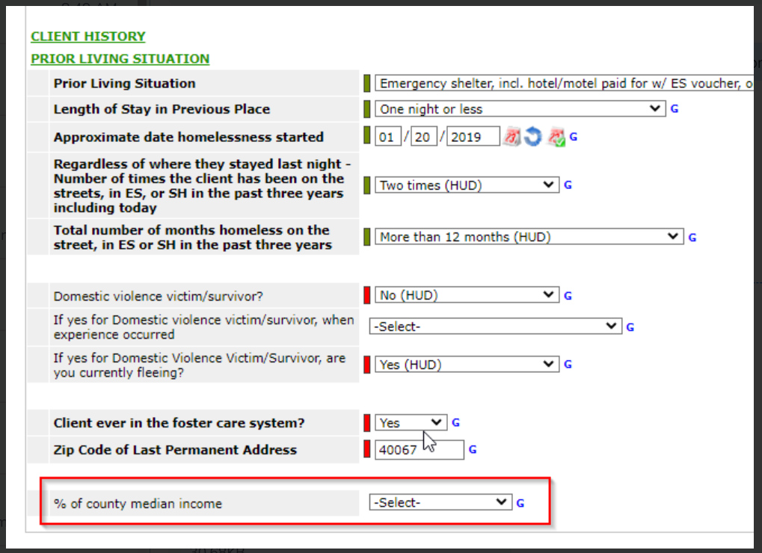
TBRA
Complete AMI Field
Notes:
Kayla

Slide 10
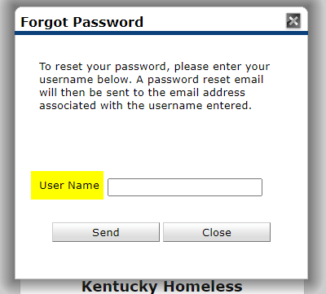
Password Reset
Select Forgot password
Enter ‘Username’
Make sure email address is correct in HMIS system
Notes:
Margaret Ann

Slide 11
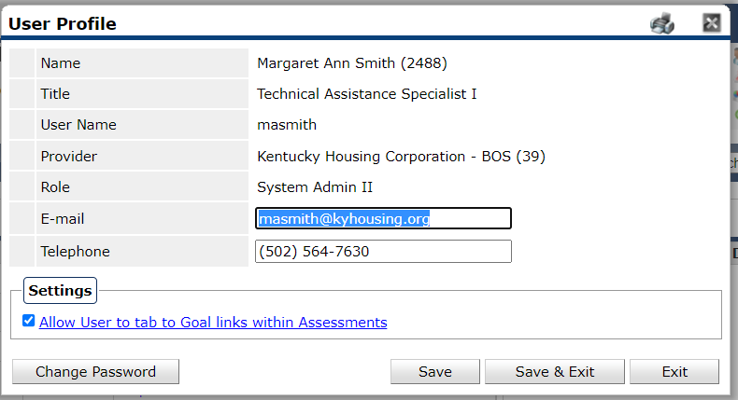
Update email address
Select the gear in the right corner by your name
Check your email in the system
Change Password if not correct
Notes:
Margaret Ann

Slide 12
Street Outreach - Reminder
576.101 - Eligible cost for street outreach: Reach out to unsheltered homeless people, connect them with emergency shelter, housing, or critical services and provide urgent, non-facility-based care to unsheltered homeless people who are unwilling or unable to access emergency shelter, housing or an appropriate health facility. Unsheltered homeless people means individuals or families who qualify as homeless under paragraph 1(i) of the homeless definition.
576.2 Homeless means: (1) An individual or family who lacks a fixed, regular and adequate nighttime residence:
(i) An individual or family with a primary nighttime residence that is a public or private place not designed for or ordinarily used as a regular sleeping accommodation for human beings. Including car, park, abandoned building, bus or train station, airport, or camping ground.
Notes:
Margaret Ann

Slide 13
Data Quality
All Data Quality Reports due on the 15th of every month
When submitting your canned Data Quality Framework, please remember to provide an explanation for any errors on any of your reports each month. With the exception of errors that take a year to come off.
Send reports to kyhmisdataquality@kyhousing.org
All Data Quality Instructions can be found on the HCA Help Desk
Updated Data Quality Report Calendar on Help Desk
Notes:
Sara

Slide 14
Data Quality - TBRA
Data Quality Framework Reports and Corrective Action Forms are due to the KYHMISDataQuality mailbox by COB on the 15th of March, June, September, and December
Notes:
Sara

Slide 15
Agency Performance Accomplishments
Barren River Area Safe Space, Inc. (BRASS)
BRASS -ESG-RRH
Beattyville Housing and Development Corporation
Beattyville Housing - ESG- ES(2547)
Beattyville Housing -ESG-PREV(2583)
Bethany House Abuse Shelter
Bethany House-ESG RRH
Big Sandy Area Community Action Program, Inc.
Big Sandy Area Comm Action-ESG-RRH(2101)
Clark County Community Services
CCCS-ESG-RRH(2042)
CCCS-ESG-Prev(1471)
Community Assistance & Referral Services, Inc. (CAReS)
CAReS-ESG-Prev(1939)
Community Outreach
Community Outreach-ESG-RRH(2111)
Daniel Boone Community Action Agency
DBCAA-Ashlee's House-ESG-ES(1676)
DBCAA--ESG-RRH(2055)
DOVES of Gateway
DOVES-ESG-ES
DOVES-ESG-RRH
Gateway Homeless Coalition, Inc
Gateway -ESG-RRH(2049)
Harlan County Community Action Agency, Inc.
HCCAA - ESG-RRH(2280)
Jesus Community Center Shelter
Jesus Community Center-ESG-ES(523)
Jesus Community Center-ESG-RRH(2048)
Kentucky River Community Care
KRCC-ESG-ES(411)
KRCC-ESG-PREV(2087)
KRCC-ESG-RRH(2097)
Safe Harbor of Northeast Kentucky
Safe Harbor-ESG-RRH
Sanctuary, Inc.
Sanctuary-ESG-ES
SpringHaven, Inc
SpringHaven-ESG-RRH
Notes:
Sara

Slide 16
Learning Management System (LMS)
LearnUpon
Notes:
Margaret Ann

Slide 17
Poll Question
Have you logged into LearnUpon?
Yes
No

Slide 18
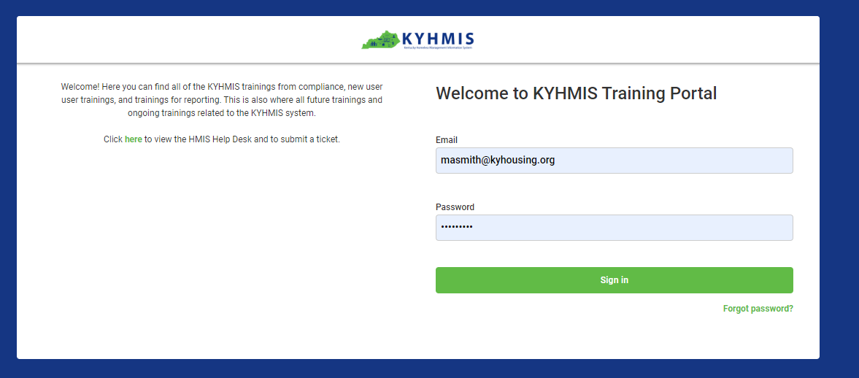
Learning Management System (LMS)
Notes:
Margaret Ann

Slide 19
Learning Management System (LMS)
Notes:
Margaret Ann

Slide 20
Course Status Report
2022 Security and Privacy Training
189 Completed
70 Not Started
10 In Progress
KYHMIS BOS Annual Refresher Training
108 Completed
54 Not Started
80 In Progress
Notes:
Margaret Ann

Slide 21
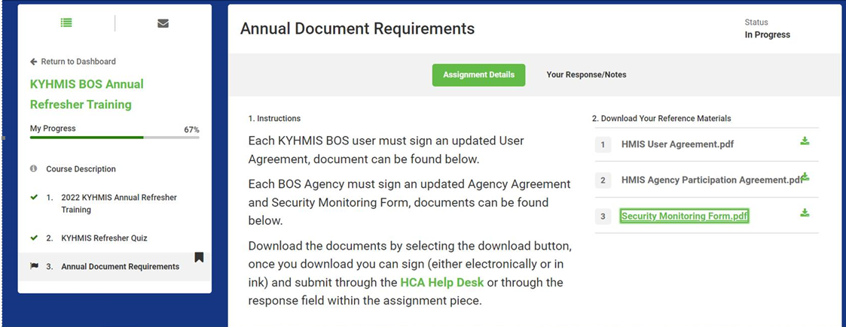
LearnUpon
Make sure to click through the entire course
Respond to any assignments using ‘Your Response/Notes’ within the assignment
Notes:
Margaret Ann

Slide 22
LearnUpon – Refresher Quiz

Slide 23
Upcoming requirements
Annual Documents
ALL KYHMIS users will need to sign Annual Documentation for this fiscal year
signed User Agreements for ALL KYHMIS users and
Agency Agreements as well as the KYHMIS Security Monitoring Form
Refresher Training and Security Training
All Users will have to complete the trainings through LearnUpon
Security Training must be completed by ALL users even Recover Kentucky Users
Refresher Training must be completed by BOS users
Annual Invoicing – have been issued; payments due August 6 (past that date will be receive 10% late fee)
Notes:
Margaret Ann

Slide 24
Job Posting
System Administration Specialist II
Notes:
Margaret Ann

Slide 25
Next Meeting
October 26, 2022- 1:30 PM EST
Register Here
Notes:
Margaret Ann Smith

Slide 26
Questions?
Notes:
Margaret Ann Smith

