Slide 2
KYHMIS BOS Quarterly Meeting
April 27, 2022
1:30 PM
Notes:
Margaret Ann Smith

Slide 3
agenda
Reporting
CoC APR
ESG CAPER
Data Quality
Client Data Entry
CE Assessment
Anonymous Client
Reporting Tool
Learning Management System (LMS)
Annual Invoices and Requirements
Questions
Notes:
Margaret Ann Smith

Slide 4
CoC APR-reminders
APRs are due to KHC 45 days after the end of your grant period (varies per agency)
You should receive an automatic email once your grant period ends, this will notify you of your due date to KHC with instructions for submitting
Typically, these are sent to the agency financial person (whom has web-draw user access) and to the HMIS contact.
If you would like to be added as an additional contact, please email KYHMISReporting@kyhousing.org or submit an HCA Help Desk ticket
Check your data and make all necessary corrections before submitting
Reach out to KHC if you have any budget modification needs (including admin) prior to your grant period end date
If you make a Final Draw, you must wait at least 3 days to a week to submit your APR (for the financials to be captured correctly on your form)
Notes:
Kayla

Slide 5
ESG CAPER Reporting-who its for
You will be asked to report for the ESG CAPER if…
If you receive or received regular ESG funds during the July 1st, 2021, through June 30th, 2022, reporting period.
Important Note:
If you have an Emergency Shelter or Street Outreach project that was funded with both regular ESG and ESG CV
Meaning both funding sources are used with the same project in HMIS

Slide 6
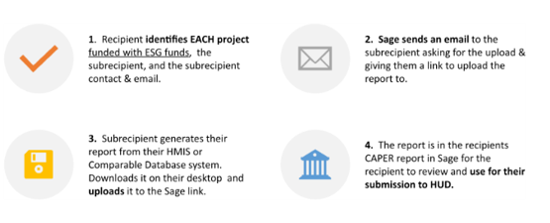
ESG CAPER Reporting-how it works
ESG CAPER Reporting (regular ESG funding)
July 1, 2021, though June 30, 2022
Notes:
Kayla
Here is a little visual (from our HUD friends) that will help to explain how the ESG CAPER Reporting works.

Slide 7
ESG CAPER Reporting-what we need now
ESG CAPER Reporting (regular ESG funding)
July 1, 2021, though June 30, 2022
An agency may have more than one component thus will receive multiple links from SAGE to upload each individual component’s project (ES, TH, RRH, SO, PREV)
Our team is requesting that each agency submit contact information for who they would like to designate as their ESG Report Contact. (If that person is different from last year).
Send an email to KYHMISReporting@kyhousing.org with the ESG Report Contact information
(Name, email, phone number)
This person will be responsible for receiving the link(s) from SAGE and uploading the ESG CAPER report(s) via the link
Please submit by no later than May 31st by C.O.B
Notes:
Kayla

Slide 8
ESG CAPER Reporting-what to expect
ESG CAPER Reporting (regular ESG funding)
July 1, 2021, though June 30, 2022
Once all ESG Report Contacts are received and/or confirmed, they will be added into KHC’s system as well as SAGE’s system
Mid-June (around June 15th) the ESG Report Contact will receive an automatic email from KHC
This email will have instructions and detailed information for What to Expect for your ESG CAPER Reporting
It is important to let KHC know if you do not receive this email, so we can work out any issues before the SAGE links are sent July 1st. (You can send an email to KYHMISReporting@kyhousing.org or submit an HCA Help Desk ticket).
Tip: Check SPAM or JUNK folder for emails if you do not see them in your mailbox
ESG CAPER Reporting begins July 1st, (meaning the SAGE links will be sent on this day)
Agencies will have until July 15th to submit their CAPERs via the link
Notes:
Kayla
For my last slide-I’ve put together a little timeline or What to Expect .

Slide 9
Data Quality
All Data Quality Reports due on the 15th of every month
When submitting your canned Data Quality Framework, please remember to provide an explanation for any errors on any of your reports each month. With the exception of errors that take a year to come off.
Send reports to kyhmisdataquality@kyhousing.org
All Data Quality Instructions can be found on the HCA Help Desk
Updated Data Quality Report Calendar on Help Desk
Notes:
Sara

Slide 10
Data Accuracy
Notes:
Sara-talking point slide
Just want to remind everyone to make sure that their data is as accurate as possible and that if they have any issues with errors they can’t correct they should contact the help desk. Making sure that they do the Annual Assessment within +/- 30 days, and to make sure to exit people when they leave and fill out their exit destination if they can.

Slide 11
Agency Performance Accomplishments
Kentucky River Foothills
Notes:
Sara

Slide 12
Data Quality Feedback and Next Steps
Notes:
Danielle

Slide 13
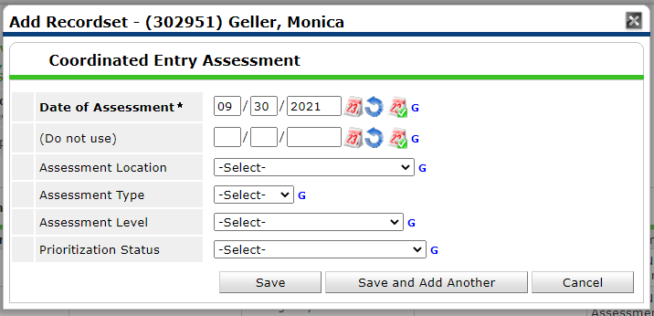
Coordinated Entry Assessment
When entering a client into the CE project make sure you are completing the Coordinated Entry Assessment
Not completing this the client will not show up on the CE APR that is sent to HUD
Notes:
Margaret Ann
Messages have been sent by LA for clients that had not completed these fields – make sure that you read this email and completed it

Slide 14
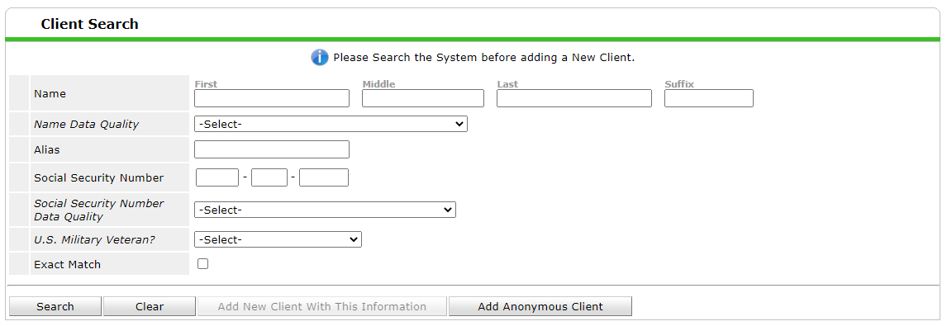
Anonymous Client
Do not use the Anonymous Client button!!

Slide 15
Poll Question
Please select Yes or No – Do you use ART?
Notes:
Danielle

Slide 16
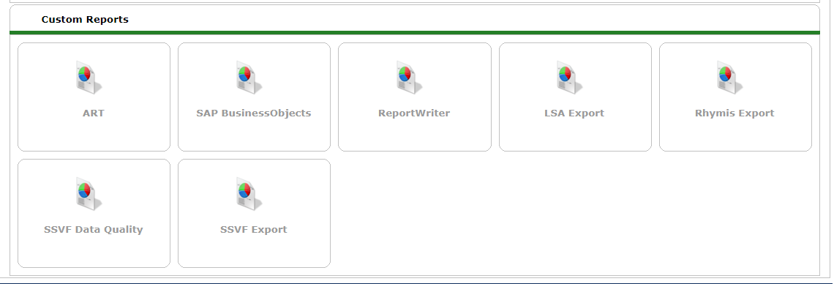
Reporting tool
Art will be going away May 14 – you will no longer have the ART button
The new reporting tool is SAP Business Objects
Notes:
Danielle

Slide 17
Learning Management System (LMS)

Slide 18
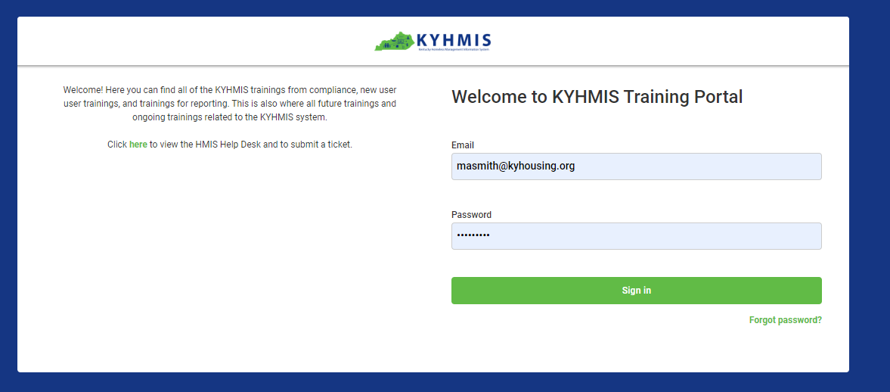
Learning Management System (LMS)
Notes:
Margaret Ann

Slide 19
Learning Management System (LMS)

Slide 20
Learning Management System (LMS)
New Training Process
New user will submit a Help Desk ticket requesting training
I will give user access to the LMS as well as the Training site
The LMS will guide them on the trainings they have to complete
Notes:
Margaret Ann Smith

Slide 21
Upcoming requirements
Annual Documents
ALL KYHMIS users will need to sign Annual Documentation for this fiscal year – eGram will go out closer to the time
We will need updated signed User Agreements for ALL KYHMIS users and Agency Agreements as well as the KYHMIS Security Monitoring Form
Refresher Training and Security Training
All Users will have to complete the training it will be conducted through our LMS – links will go out the first of June to all KYHMIS BOS Users
Users will have the month of June to complete this training – this is a requirement of your license
Annual Invoicing – first part of July
Notes:
Margaret Ann

Slide 22
Intermediate Training
April 28, 2022; 3:00 pm est
https://attendee.gotowebinar.com/register/1184734096743481356
Notes:
Margaret Ann Smith

Slide 23
Next Meeting
July 27, 2022- 1:30 PM EST
https://attendee.gotowebinar.com/register/2749833919743668491
Notes:
Margaret Ann Smith

Slide 24
Questions?
Notes:
Margaret Ann Smith

