Slide 2
Spring Training 2026
Welcome and Introductions
Housekeeping
Presenters
HCA Team
Attendees
Contact information: hcadev@kyhousing.org
In person accommodations
  Refreshments
  Restrooms
Chat and Q&A
  HCA team monitoring
Recording and PowerPoint available on Partner Agency Portal and LMS.

Slide 3
Housing Contract Administration
What do we do?
Notes:
You’ve now heard who we are, so let’s dive into what do we do?
Provide developers, like you with the funding to provide safe, affordable housing across the commonwealth.
How do we do that?

Slide 4
Buckets of HCA Funding
HOME
AHTF
RHTF
Homebuyer Development
ERR Requirement
Federal Funds
Homebuyer Development
Home Repair
State Funds
Disaster Counties
HB Development
Home Repair
State Funds
23
25
New Construction Only
State Funds
Notes:
Define HOME, where to find regs. Hud exchange trainings. Congressionally appropriated each year with the passing budget.
AHTF- define, originated in 1992, $6 of every recording fee from the state funds this bucket.
RHTF- define, no a promised set of funds but a crucial one, since it has helped to address the affordable housing supply gap that only widened with both the Eastern KY floods and the WKY tornado.
RH23 and RH25 have very different purposes...
Take a deeper dive into these buckets:

Slide 5
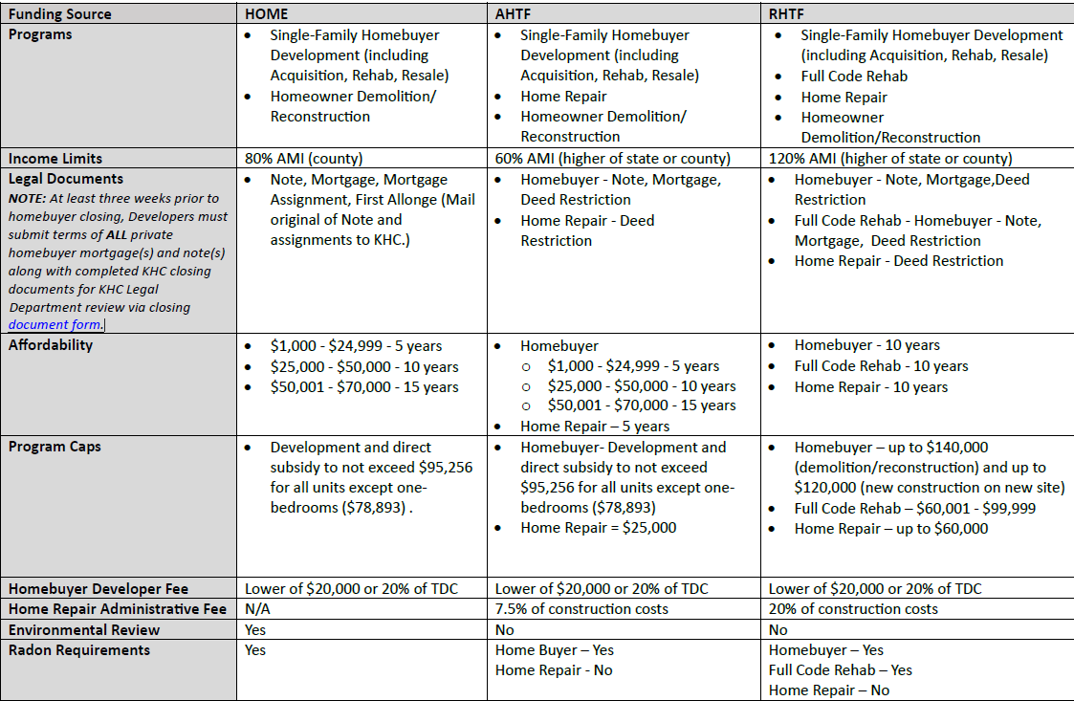
Notes:
TT- Drop Link to updates Crosswalk in the Chat.
Differences only here:
AMI- AHTF 60%, HOME 80% RHTF120%
Legal Documents- AHTF and RHTF Home Repair we just need a deed restriction. RHTF and AHTF Home buyer activities, we have a Deed restriction, a Mortgage and a Note, HOME docs include that Note, mortgage, mortgage assignment, and first allonge. No deed restriction for HOME. Mail originals of Note and assignment to KHC.
Affordability- with the 2026 policy manual we have updated the affordability chart.
Developer Fees,
HR admin fees
Radon Requirements have been included in the new Minimum Design Standards and must be included in each houseplan approval. The only activity that does not require radon compliance is HR.

Slide 6
Application
Completed in KHC Universal Funding Application (UFA)
Notes:
As all of you have completed the application process at this point, we will only spend a minute on this.
We do have a training available on the Partner Agency Portal from 2024.
https://wapps.kyhousing.org/UFA/User/Login

Slide 7
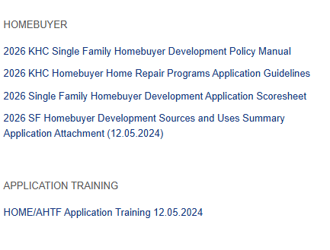
Application Process Tips
Use your resources:
  NOFA
  Scoresheet
  HCA Team
Pay your application fee before hitting submit.

Slide 8
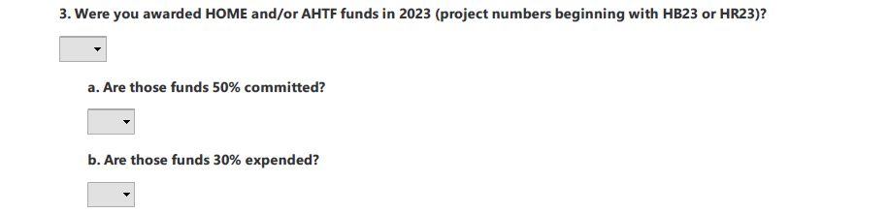
Threshold Highlights
Know your expenditure rates before completing the threshold section.
In order to meet threshold, you must have met the requirements for both HB and HR.
Notes:
If you select no, and explain why you did not meet the threshold, this is a 15-point deduction. If you answer yes but you only met the requirement for the application in which you are applying, this will result in the scoring committee not being able to complete scoring. The scorecard is a hard stop.

Slide 9
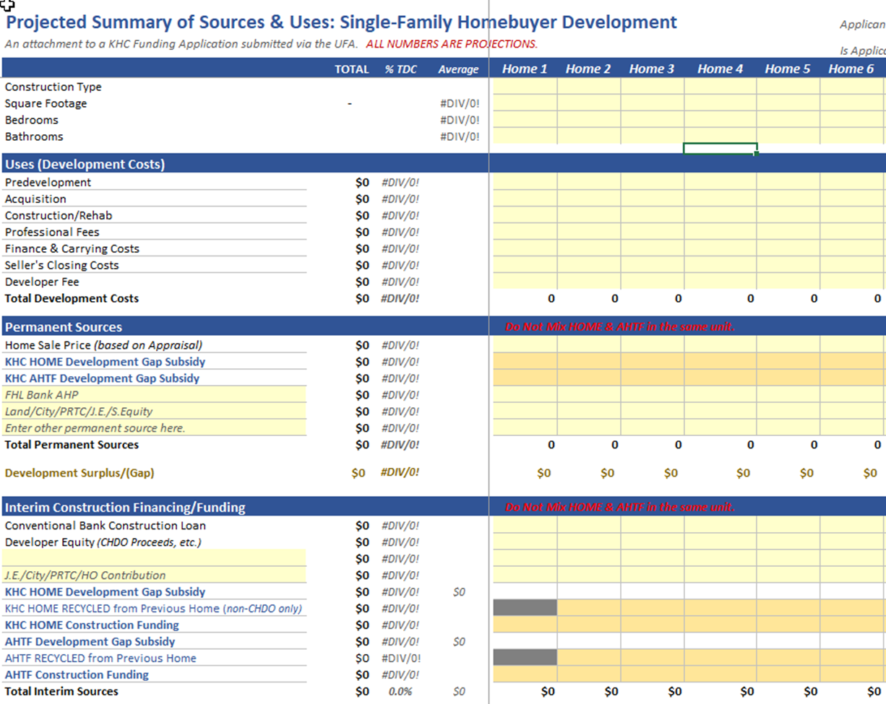
Sources and Uses
Purpose:
You’ve told KHC your plan in the application, now show us numbers.
This document is an estimation only.
Tips:
Include all funding sources cited in application.
HOME/AHTF is not a dpa only program, must have funds in direct subsidy and construction.
Ensure your sources and uses matches your application funding ask.

Slide 10
Technical Submission
Closes May 8, 2026
Notes:
You’ve completed your application, you were awarded funding, and now you’ve been asked to do Technical submission.
What are these documents and why do we need them??

Slide 11
Documents
Revised Sources and Uses- only if awarded amount is changed.
Authorized Signature Form
Signatory Authority Policy (signed by the board)
Title VI self- survey
HCA Form 229
Recent Financial Audit

Slide 12
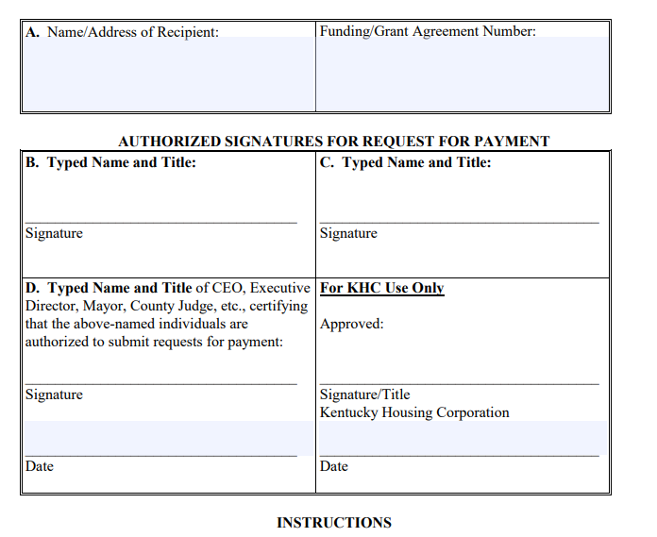
Authorized Signature Form
Signatory Authority Policy acts as supporting documentation for roles identified in this document.
ASF updates
Notes:
Most often, the Signatory Authority Policy is included in your Bylaws.
ASF updates, if you have folks leaving their positions, we can update that ASF at any time. You would complete that in the Program Draw Funding System, which we will get into.

Slide 13
Technical Submission
Addendum to your original application and must be completed in the UFA.
New Requirement: Grant Agreements and HOME Conditional Commitments will be included in Technical Submission uploads.

Slide 14
Release of Funds
Includes:
  Grant Agreements
  Access request to Project in PDMS
  Access link to your Developer Dashboard
  Sign up for eGrams
Developer receives Release of Funds email within about a month of Technical Submission closing.
Notes:
Release of Funds normally happens within the month, as long as we have all of the documents.
Now what?

Slide 15
Homebuyer 1st Activity
Application
Technical Submission
Release Of Funds
Submit House Plans for approval
Identify Properties
If HOME screen for issues ; submit HEROS ERR
Identify a Client
Submit Activity Setup
Release of Activity Funds- Activity begins
Inspections for Footer and Framing Scheduled
Submit Closing Documents 3 weeks prior to closing
Final Inspection
Final Draw
Activity Completed!

Slide 16
Home Repair 1st Activity
Application
Technical Submission
Release Of Funds
Identify Clients
Assess property for MHS
Submit Activity Setup
Release of Activity Funds- Activity begins
Schedule Final Inspection
Submit Final Draw
Activity Completed

Slide 17
Developer Dashboard
Smartsheet Link
Notes:
So, we’ve got our ROF for the project, we’ve identified a property that would be perfect for HOME, and I’ve got a client who wants to build.
I’m going to first go to my handy dandy developer dashboard

Slide 18
Closing Documents
Submitted to KHC for legal review at least 3 weeks prior to projected closing date
If HOME AUGF, must submit mitigation with closing documents.

Slide 19
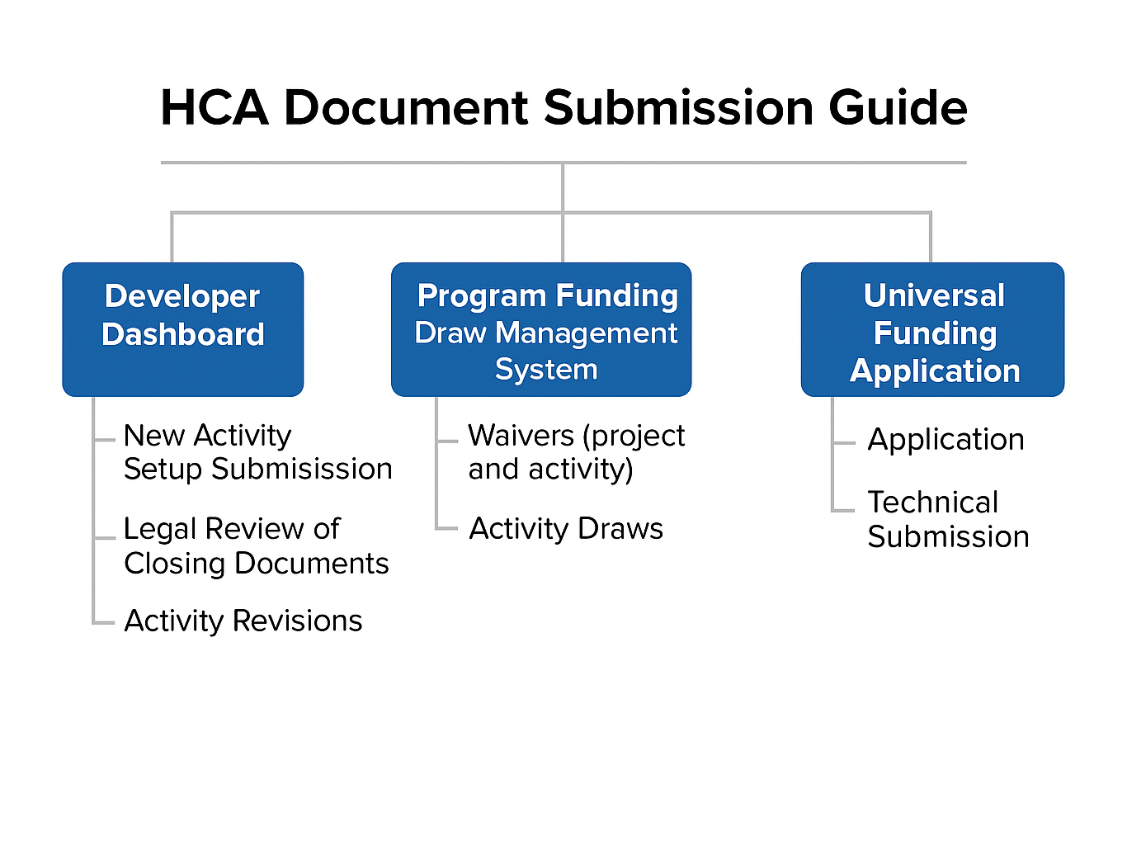

Slide 20
Developer Dashboard
Link

Slide 21
Program Funding Draw Management System
Link

Slide 22
PFDMS Functions
Team Management
  Update team roles
Submit revised ASF
Access Interim and Final Activity Draws
Submit Waiver Requests

Slide 23
Team Management
Roles
View Only- can access the draw but cannot create or submit
Preparer- creates and prepares draws but cannot submit the final draw
Signatory Authority (SA)- Can create a draw, prepare, and submit. MUST be included on the ASF for the project.

Slide 24
Draw Requests
Homebuyer Draws:
    Footer
    Framing
    Final (must be done within 90 days of closing)
Interim draws must not exceed 90% of KHC funding, 10% remains for final.
Home Repair Draws:
    Initial
    Final
Final draws must be submitted within 90 days of final inspection.

Slide 25
Waiver Submission Process
When to submit a waiver:
When not to submit a waiver
  Ratio waivers
  Conflict of Interest
  Direct Subsidy for more than 50K
  Project Extensions
  Project Specialist requests waiver.
Setup Revisions
Closing document submission
Draw Requests

Slide 26
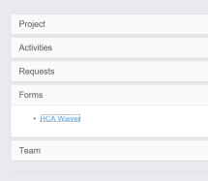
Waiver Submission Process
Completed in Draw System
Use Project Number only HB2#-####-01
Attach supporting documentation
Clarify request in the description
Track decision in Developer Dashboard.

Slide 27
Email

Slide 28

Hcadev@kyhousing.org
Direct contact to HCA team for general questions
Developer Dashboard access link request/ edits

Slide 29
Environmentalreview@kyhousing.org
Consultation Requests:
  THPO
  Farmland
  Floodplain management
Mitigation Documents

Slide 30
KHCinspectionsRequests@kyhousing.org
Inspection Request Forms
  Located on Partner Portal
House plan Submissions
Change Orders
MDS and MHS inquiries

Slide 31
Project Specialist Email
Revised documents during specialist review
  Activity Revision Form is reserved for after ROF.
Questions about assigned documents/ process.

Slide 32
HCA Document Submission Guide Update
Developer Dashboard
Activity Setups
PFDMS
Interim Draws
UFA
Application
Email
Closing Doc Legal Review
Activity Revisions
Final Draws
Waivers
Technical Submission
ERR Consultation
Process/ Review Questions
Inspection Items

Slide 33
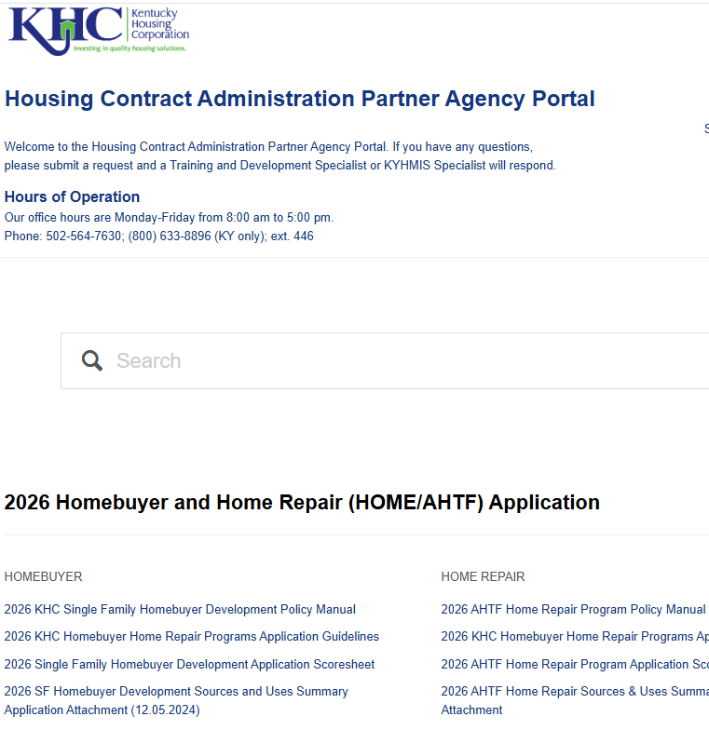
Partner Agency Portal
Acts as our document resource library.
Setup Templates
Policy Manuals
Income Limits
Compliance Guidance
Closing Document Templates
Application Guidelines
Quick link available on your developer dashboard

Slide 34
Homebuyer
HOME, AHTF, RHTF

Slide 35
The Process
Find the most recent set-up packet on Partner Agency Portal.
Complete set-up packet
Submit all required items on the checklist via Activity Setup Form
KHC HCA staff reviews

Slide 36
The Process
HOME Developer Written Agreement is processed...
  KHC will draft and send to Signatory Authority for review and signature
  Developer returns
KHC inputs into IDIS
HCA sends activity approval/ release of funds with executed DWA and Activity Number
Construction and Inspections begin

Slide 37
CHDO
What is a CHDO?
  Community Housing Development Organization
  Retain proceeds
What Funds a CHDO?
  PJ’s must set aside funding for CHDO's
Where can I find out more?
  Training on LMS and Partner Agency Portal

Slide 38
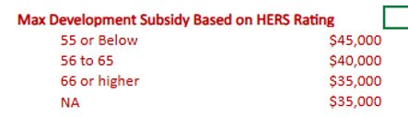
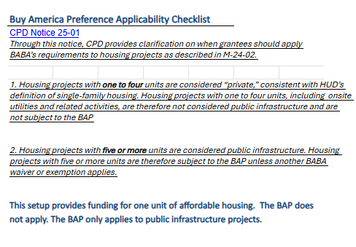
Compliance and Underwriting
BABA Checklist Language added to the HOME compliance header
HERS rating determines development subsidy amount

Slide 39
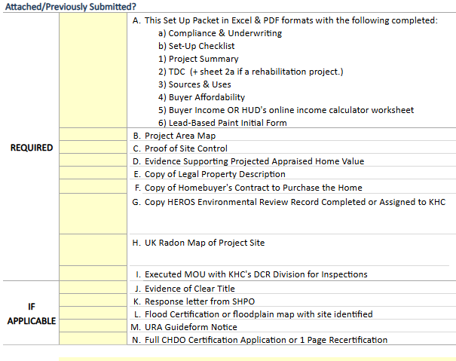
Setup Checklist Hiccups
Clear Title -
Title Opinions should have all supporting documentation.
Proof of Site Control
Deed, Purchase Option, 99 yr lease

Slide 40
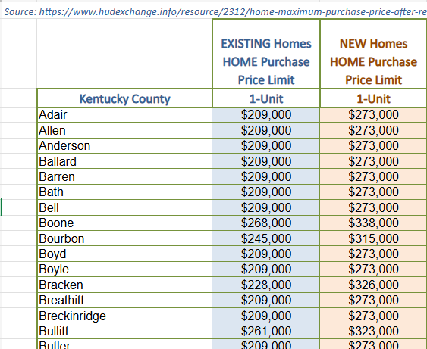
Setup Checklist Hiccups Continued
Appraisals-
Sets the home sale price
As-built Appraisal locks in the sale price for KHC.
Like appraisal is an estimate, actual appraisal will be required at PCR.
What happens if appraised value for HOME unit comes in higher than the Price Limit?

Slide 41
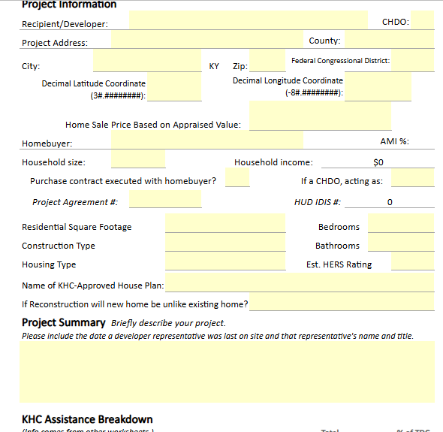
Project Summary
Project Agreement #- HB26-0000-01
Narrative Boxes:
Describe your project
Describe Ownership
  4 W's.
House Plan must be approved under 2026 MDS.

Slide 42
Total Development Costs
Construction Contingency:
  Use it! This allows for costs increases
  7.5% of Construction Costs
Developer Fee:
20% of TDC
$20,000 max

Slide 43
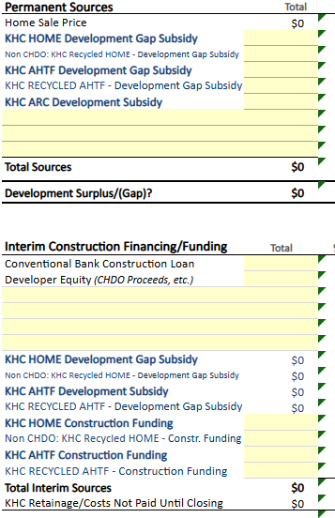
Sources and Uses
Development Gap limited to HERS rating
Buyer subsidies are not included in this tab
Must have KHC construction funding

Slide 44
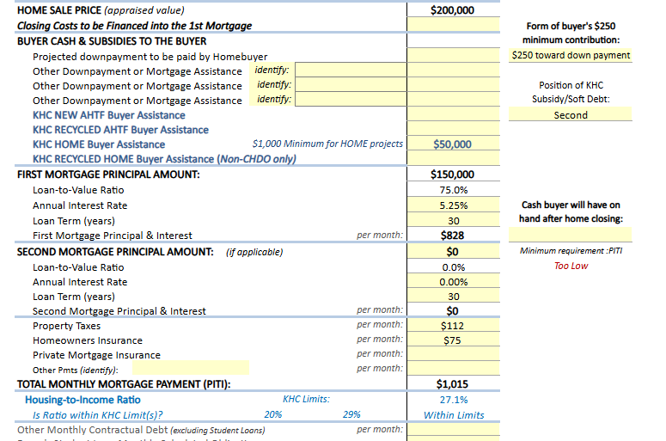
Buyer Affordability
Policy Change!!!!
KHC will require every KHC-assisted homebuyer to have a minimum cash reserve equivalent to one month’s principal, interest, taxes, and insurance (PITI) payment at the time the loan is closed.

Slide 45
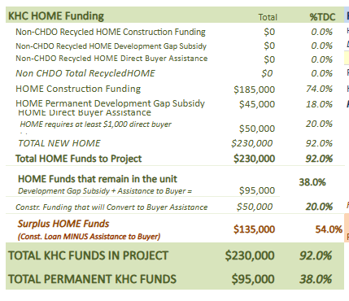
Program Income/ CHDO Proceeds
KHC con. loan - KHC buyer assistance = Program income/ CHDO proceeds.
If AHTF this amount will need to be returned to KHC before final draw.
If Non-CHDO HOME, this amount will also need to be returned to KHC before final draw
What Happens to PI?

Slide 46
Buyer Income
Include all household members in the income and assets tab.
Passbook rate for assets has changed to 0.40%
If you have questions about Income Calculations, please reach out to HCA compliance team.
Dates of Verification for asset and income must be within 6 months of setup submission.

Slide 47
Radon
AHTF, HOME, RHTF

Slide 48
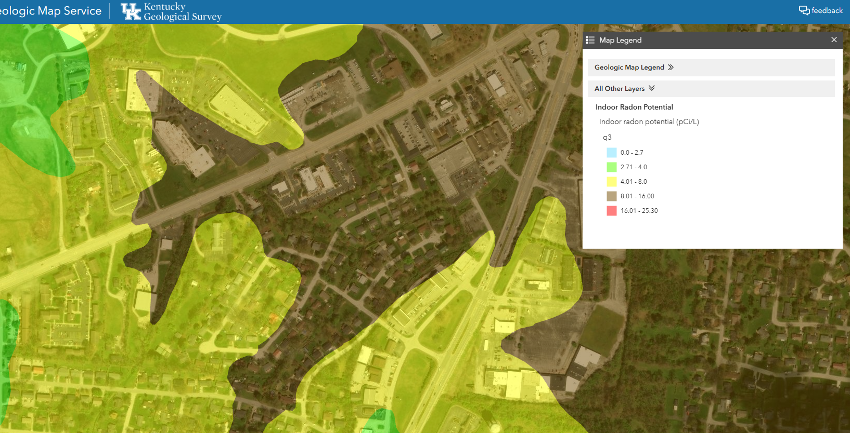
Radon Map
https://kgs.uky.edu/kygeode/geomap/?layoutid=2009.

Slide 49
HOME Radon Process
AUGF ERR
Radon listed as mitigation requirement
Construction Completed
Schedule radon test
Closing Documents Form
Include cost of mitigation
Include results of test
Include updated mitigation plan.
Radon map indicates above 2.7
Test Results below 4.0, schedule final inspection

Slide 50
AHTF/ RHTF Radon Process
Setup Submitted
Construction Complete
Radon test
If below 4.0 include in closing documents form and provide at final inspection
If over 4.0, mitigate, retest until below 4.0pCi/L
Final Draw
Radon Map
Below 2.7 Stop
Above 2.7 plan for testing
Include radon test results

Slide 51
Environmental Reviews
HOME funded units

Slide 52
AUGF- Mitigation Required
Mitigation must be completed before final inspection
Track mitigation plan throughout the build
Must include updates in closing form
  Include cost of mitigation
  Update the mitigation plan
Must receive link to updated ERR before PCR

Slide 53
ERR Process Timeline
Property Identified
Prescreen
Submit ERR in HEROS
Public Notice Posting
NOI/RROF 8 day posting
30-day HUD review period
Submit consultations requests to KHC
ERR Clearance
AUGF received or
HOME setup submitted
Construction Completed
ERR archived
Mitigation plan updated if AUGF
Submitted to KHC
Updated ERR received
Submit final draw

Slide 54
Resources
Wiser Modules- https://www.hudexchange.info/trainings/wiser/
ERR Completion Guide- https://kyhmis.zendesk.com/hc/en-us/articles/360011687174-HEROS-Environmental-Review-Completion-Guide-HOME-Single-Family

Slide 55
Home Repair
AHTF

Slide 56
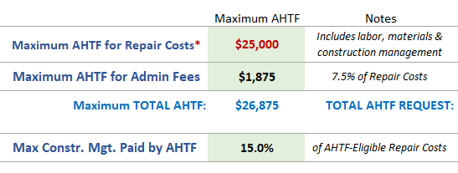
Compliance and Underwriting
Construction management costs are witihn the total AHTF repair costs
Entire unit must meet Minimum Habitability Standards (MHS) at final inspection
If manufactured home/ mobile home is being assisted client must own both the home and the land it sits on.

Slide 57
Photo Requirements
In liue on an onsite first inspection we require photos of:
  Exterior sides of the house
  Property
  Any repairs addressed in the repair scope
Attach pictures as one single PDF document and submit via Activity Setup Form

Slide 58
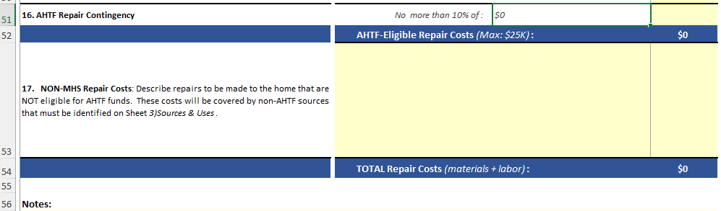
Repair Scope
Each line addresses a MHS
  Explain how unit meets or does not meet MHS
AHTF Repair contingency
  10% of AHTF Repair Costs
Non MHS Repair costs- use this section to identify costs not covered by AHTF

Slide 59
RHTF

Slide 60
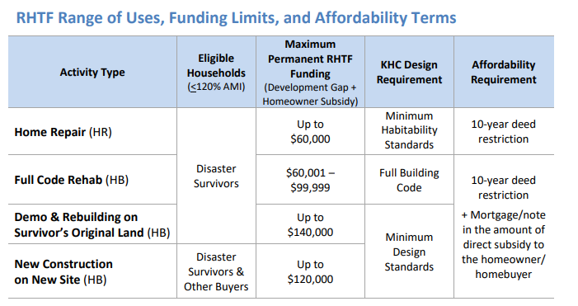
23RHTF Uses Chart

Slide 61
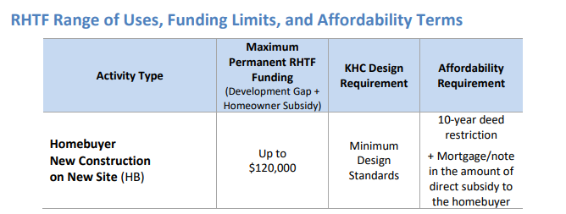
25 Uses Chart

Slide 62
Unique RHTF Requirements
Estate Planning
10 year affordability regardless of buyer assistance
New construction units must receive HERS of 55 or below
Permanent subsidy total limit

Slide 63
Closing Documents
Homebuyer Activities

Slide 64
Common Hiccups
Maturity Date
  Match affordability for direct subsidy amount
  Update to align with closing date
Assignments
  KHC funding amount and not 1st mortgage
Notary
  Includes number
  Same date as closing
Pull NEW template for each closing
Recorded info should have book and page number
Record 1st mortgage before 2nd

Slide 65
PCR
All Projects

Slide 66
Before you submit PCR
Do you have:
100% final inspection
Mailed in Note and Note Assignment (HOME only)
Mailed in PI (if applicable)
Archived ERR (HOME)

Slide 67
Final Draw
Draw Amount should match your workbook amount:
DO NOT use Adjust Draw!!!
Decrease total requested amount
If you have an increase in KHC funds, activity revision is required

Slide 68
Final Draw
Explain variances in you PCR workbook
Costs must be documented
  Only send those in if selected for PCFR or monitoring
    Easily tracked in general ledger
Submit within 90 days of either:
  Final Inspection (HR)
  Closing date (HB)

Slide 69
Draw Timeline
Draw Received
Preparer submits to Signatory Authority
KHC Inspection Review
Draw is assigned to KHC inspector team
HCA
Draw is assigned to HCA Project Specialist
Signatory Authority submits to KHC
Agency can begin tracking in Smart Sheets
CPA
CPA releases funding to accounting and updates IDIS
Accounting
Processes payment
Funds Disbursed

Slide 70

Project Closeout
Unit Commitment met
Funding expended
PI or Recycle has been returned to KHC

Slide 71
Questions

