Slide 2
KYHMIS BOS Quarterly Meeting
October 27, 2021
1:30 PM
Notes:
Margaret Ann Smith

Slide 3
agenda
Reminders
Exiting Clients
Community Integration Supplementation
Data Standards Updates
Help Desk
Data Quality
Questions
Notes:
Margaret Ann Smith

Slide 4
Reminders
Covid Vac Question
Households
Make sure to check the household tab and if there is an existing household (including all your same clients) don’t create a new household – use the one that already exists.
Search your client before creating a new one
Search by name and last 4 digits of SSN
Submit a ticket if a duplicate client was mistakenly created
New Users to the HMIS system
Invoicing
Intermediate Training
eGram

Slide 5
Exiting clients
ES project exits- make sure that the exit date is at least the day before the housing move in date for the PH or RRH project.
PSH/RRH projects- make sure the housing move in date (HMID) does not overlap with any other projects
Housing move in date-date client physically moves into housing
Notes:
Kayla

Slide 6
Exiting clients
Notes:
Kayla

Slide 7
Community Integration Supplementation
What is CIS?
CIS is a type of State Supplementation that allows individuals, with a serious mental illness, at risk of entering a Personal Care Home (PCH) or other institution, a way to maintain their residence in the community.
Notes:
Kayla

Slide 8
Community Integration Supplementation
Who is eligible?
Individuals with a Serious Mental Illness
Individual must have need for care and support above and beyond room and board
Notes:
Kayla

Slide 9
Community Integration Supplementation
How to Apply for CIS
In-person at a DCBS office; or
Through our Call Center 855-306-8959;
State Supplementation, including CIS, cannot be applied for through the self-service portal at kynect.ky.gov.
Notes:
Kayla

Slide 10
Agency Performance Accomplishments
Catholic Charites
Notes:
Kayla

Slide 11
FY 2022 Data Standard Updates
Effective October 1, 2021

Slide 12
Data Standard Updates
Most assessments have been updated
Still working on SSVF
Most Data Collection forms have been updated
Still working on SSVF
All reports should be updated at this time
Excluding CSV exports from the system – YHDP and SSVF

Slide 13
Client Search

Slide 14
Client Demographic updates - Gender
*
*to select more than one gender use the Ctrl button

Slide 15
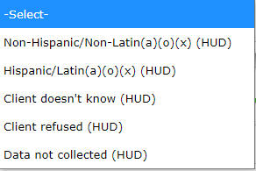
Client Demographic updates – Race, Ethnicity
Ethnicity
Race
There is still Primary and Secondary Race selecting the ones that the client can best relates to.

Slide 16
Data Standard Updates – Well Being Questions
These questions are only on the CoC-PSH assessments

Slide 17
FY 2022 Data Standard Updates
*NEW – Moving On Assistance Provided
Collected each time move-on assistance is provided
Questions have been added to Update and Exit Assessments

Slide 18
Data Standard Updates - YHDP
Update to Youth Education Status
Most Recent Educational Status…
Current Education Status…

Slide 19
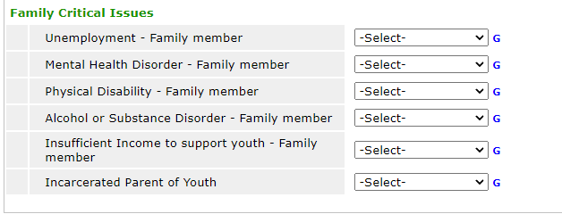
Data Standard Updates - RHY
Wording changes on RHY – Family Critical Issues questions.

Slide 20
Data Standard Updates - SSVF
Financial Assistance
Targeting Criteria

Slide 21
Help Desk – take a tour

Slide 22
Data Quality
All Data Quality Reports due on the 15th of every month
When submitting your canned Data Quality Framework, please remember to provide an explanation for any errors on any of your reports each month. With the exception of errors that take a year to come off.
Send reports to kyhmisdataquality@kyhousing.org
All Data Quality Instructions can be found on the HCA Help Desk
Updated Data Quality Report Calendar on Help Desk
Notes:
Danielle

Slide 23
Data Quality
Date Range
Corrective Action
Data Quality Framework report
Housing Move-in date workflow
Provider profile – data quality
System Performance Measures and LSA
Notes:
Danielle

Slide 24
Data Quality – ESG-CV
Run CAPER at the first of every month
Check all data quality errors
SSN, Income, Disability, and Relationship to Head of Household
Detail error summary
Notes:
Danielle

Slide 25
Data Useability
Useability means that that data quality is high enough to be included in the AHAR statistical model used to develop the national estimates. Can your data be used to make assumptions about other unknown data.
Useability is not simple thresholds. It is a highly nuanced process but there are things that immediately place a CoC’s data at great risk:
High rates of missing DOB prevents calculation of household type.
High rates of missing SSN impacts reliability of deduplication.
Any rates of Missing Client location prevents the data from being attributed to a community.
High missing or multiple Heads of Households adversely impacts the ability to deduplicate the count of households.
Accurate projects set up is critical. Incorrect project set up may lead to the appearance of missing projects, inventory, or people.
Notes:
Danielle

Slide 26
Next Meeting
January 26, 2022- 1:30 PM
https://attendee.gotowebinar.com/register/4938124842296662795
Notes:
Margaret Ann Smith

Slide 27
Questions?
Notes:
Margaret Ann Smith

