Slide 2
Meet the Team
Admin
Patti Siwula
Eleri Gesler
Daniel IIJAski
Keli Reynolds
Johnny Bush – starting 6/23
Technical
Mark Adams
Chase Garrett
Dewayne Cade
Troy Gosser
Johnny LuckenIIJAl
Jason Reneau
Chas Barnett

Slide 3
What is Weatherization?
Federal program – began in the 1970s
Funded under the Department of Energy & Health & Human Services Low-Income Heat & Emergency Assistance Program
KHC began administering it in 2009

Slide 4
How much does KY get?
DOE Formula = $6 million
LIHEAP Formula = $7.5 million
DOE IIJA = $51,972,421

Slide 5
Funding Crosswalk
 | DOE Formula | LIHEAP Weatherization | DOE IIJA
Funding Amount | $8,500,211 (with projected rollover) | $10,000,000 | $51,942.185
Grant Period | 7/1/2023 – 6/30/2024 | 7/1/2023 – 6/30/2024 | 7/1/2022 – 6/30/2027
State Plan Due | May 3, 2024 | Fall 2024 | Budget due July 1, 2022 Plan due October 1, 2022 Approved April 3, 2023 Revision May 2023 – will need a new revision due to indirect cost rate
Administrative | $1,258,952 (15%) | $1,000,000 (10% but not really) | $7,791,327.75
T&TA | $1,130,915 | Up to $1,232,356.24 | $9,093,261.00
Average Cost Per Unit | $8,497 for FY25 | No ACPU | Avg of 5 year ($8,009, $8,250, - $????)
H&S Cap | 15% | No Cap | 15%
Weatherization Ready | $925,197 | ------------- | None – but can braid with LIHEAP and Formula. Will use SEP funding when it is available.
Braiding | Braid with LIHEAP not IIJA | Braid with any DOE funding | Braid with LIHEAP and any DOE funding
Program Policy | No Change | Same as DOE except for a few exceptions (SIR, ACPU, H&S Cap) | Same as regular weatherization with a few enhancements
Other Requirements | None | None | Davis Bacon – multi-family units 25 and larger, Buy American – only public buildings, Justice 40
Enhancements | None | None | Contractor Incentives Career Path Out-of-State Subgrantee for Multi-family within 11 regions Solar Pilot

Slide 6
Allocations
Subgrantees (mostly CAAs + Frontier Housing)
Formula (expenditures & poverty levels)

Slide 7
Admin Tips
Admin at the end of the year should be within the % range of program expenses.
IIJA Admin should be close to the same percent with program expenses.
Drawing 100% admin without expenditures to support could result in a repay to KHC.
Review expenses to move admin to program support.
Only allocate admin expenses if you are spending in program dollars.

Slide 8
What do Program dollars do?
Conducts energy audits
Installs energy saving measures/retrofits
Installs health & safety measures
Ensures quality through certified inspectors

Slide 9
How much does it cost?
No cap on health & safety but must seek approval over $4,000
Energy Conservation Measures should average $8,497 (in 2025) in DOE funding (no cap in LIHEAP funding)

Slide 10
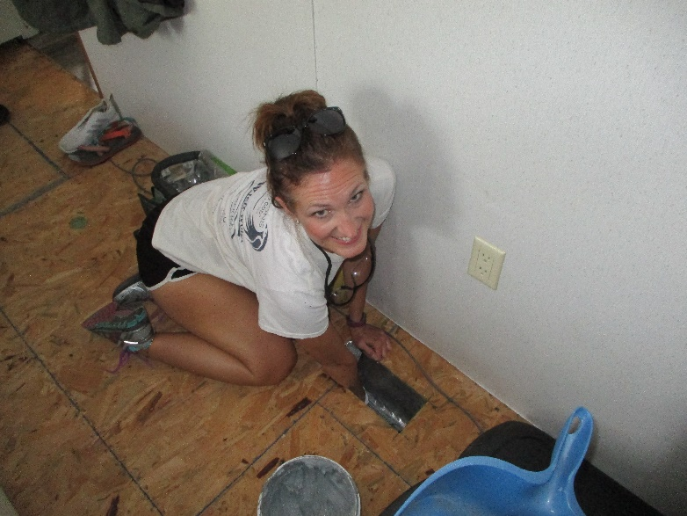
What are energy retrofits?
Air sealing (caulking windows, doors, and cracks)
Adding insulation
Replacing refrigerators and gas stoves
Ensuring heat is present

Slide 11
Are other general repairs allowed?
General repairs are allowed under Weatherization Ready.
Must be related to a deferral.
Cannot include all needed repairs; only repairs to prevent deferrals.

Slide 12
How many applications do you need?
Not every application becomes a project
Ineligible client
Deferrals and cancellations
48% deferral rate! This means nearly half of your applications are not going to turn into projects or completions!!!
This does not actually account for all deferrals since they were not required to be entered for the entire year. Some of your data suggests needing 5-6 applications per completed unit.

Slide 13
What is an appropriate deferral?
Health & safety – Ex: mold, pest infestation, asbestos
Housing Repairs – Ex: roof repair
Client issues – Ex: threats

Slide 14
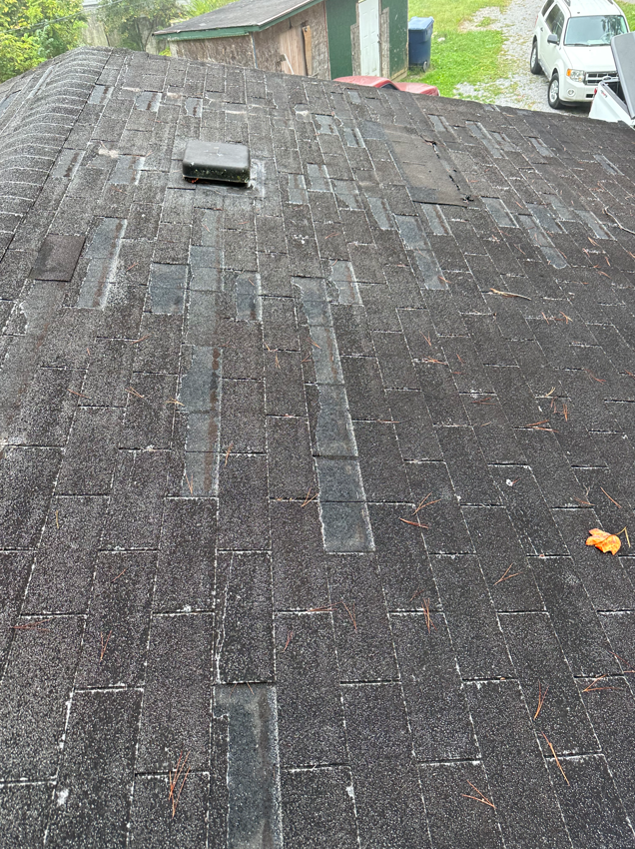
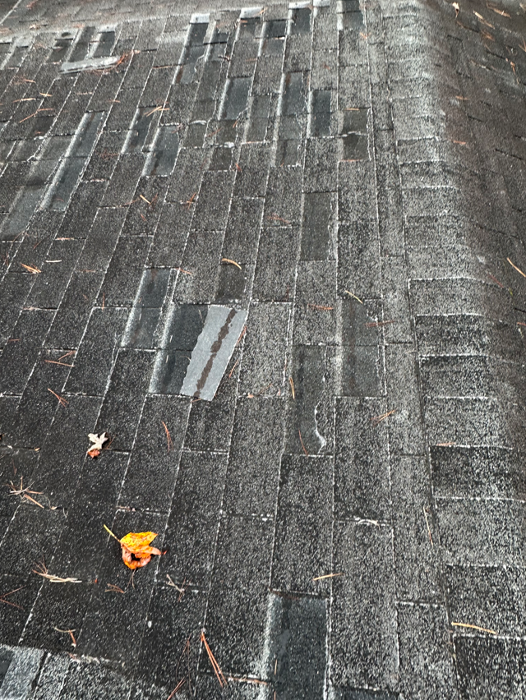
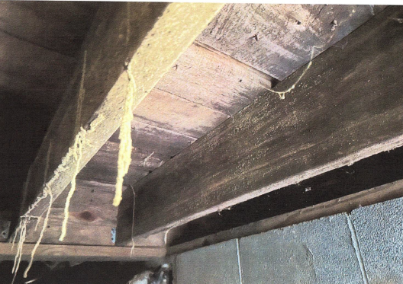
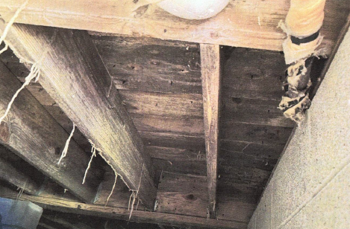
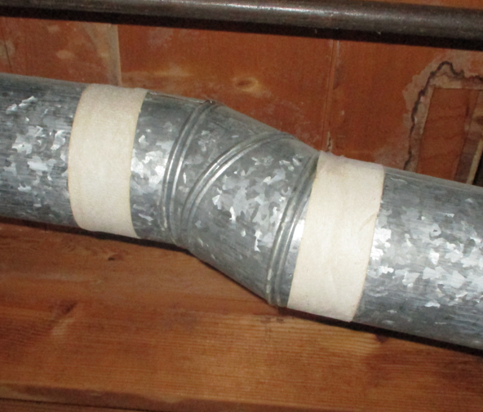
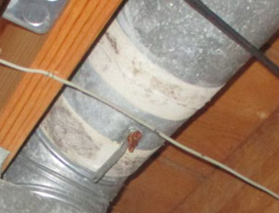
Examples of Weatherization Ready
Roof Repair
Asbestos
Mold & Moisture/Pest Infestation

Slide 15
The flip side of all of the funding . . .
Workforce development issues
Not enough contractors
Not enough crew
KHC staff are at capacity

Slide 16
Spending IIJA
Must build the workforce
Implementing a multi-family initiative through CEDA (Community & Economic Development Assoc. of Cook County)

Slide 17

Career Path

Slide 18
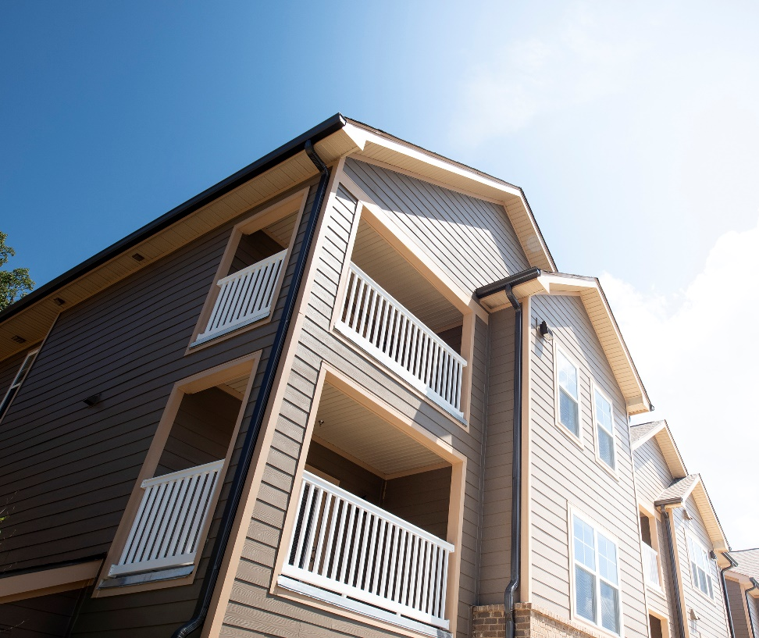
Multi-Family
Shalom Towers – Pilot – Multi-Purpose
Arcadia Park - CEDA
Recruiting Properties
Approvals
Audit Approval

Slide 19
State Averages
DOE IIJA
Target Avg over 5 Years
($8,009, $8,250, $8,497, $8,574, Yr5)
DOE Formula
Target $8,497
QTR 1 FY25
$10,329.86
(45 Completions)
QTR 2 FY25
$13,309.58
(113 Completions)
QTR 3 FY25
$11,802.85
(187 total completions)
QTR 1 FY25
$17,061.77
(236 IIJA Completions - total)
QTR 2 FY25
$17,004.71
(256 IIJA Completions - total)
QTR 3 FY25
$17,759.14
(260 total completions)

Slide 20
LIHEAP Funding Trends

Slide 21

90-Day No Cost Extension
DOE Formula Grant – extended to 9/30/2025
WX25 extensions – out in 2 weeks
IIJA25 extensions – out in 2 weeks (thru 6/30/2026)
Will re-allocate funding

Slide 22

Weatherization Ready
All Weatherization Ready and DOE projects MUST be completed by September 30, 2025.

Slide 23
Invoices Due
LIHEAP Year-End Invoices due July 11, 2025
DOE Quarterly Invoices due July 23, 2025

Slide 24

Sustainable Energy Resources for Consumers (SERC)
Rooftop Solar – WKAS, LKLP, KCEOC, Big Sandy
Triple-Pane Windows
Awarded August 2024
Submitted IIJA State Plan Revision November 2024
Contracting January 2025

Slide 25
Federal Staffing
DOE
9 Staff
Reduced from 35
Very few in Financial Accounting
Does KY have a PO?
HHS/LIHEAP
5 Staff?
Mostly in Accounting
Still have some contractors

Slide 26
Solar for All
$62 million awarded to KY Energy Cabinet
$2.6 million in admin
$13 million for homes that are weatherized
More funding for solar for disaster areas

Slide 27
KHC’s role with Solar for All
Weatherized Houses
Disaster funding – who gets it?

Slide 28
Things We Do Not Know
Will DOE Formula start July 1?
Will LIHEAP be funded again?
Is anyone nationally advocating for Weatherization?
Will we get contracts July 1?
What money do we spend on July 1?
What is happening with solar?

Slide 29
Other Housing Programs
HOME Investment Program – CHDOs
AHTF – development & repair
RHTF – development & repair

Slide 30
Questions?
Keli Reynolds 502-564-7630, ext. 414 kreynolds@kyhousing.org

