Slide 2
Relaxation
Next 4 minutes
Write down your concerns
Put them in the basket
Let them go!

Slide 3


Slide 4

Rock Stars
Nominees – Lake Cumberland, LKLP, Northeast, Northern, and PACS
Entertainer of the Year – LKLP – Leading in Job Completions
Album of the Year – Northeast – Leading in Expenditures
Best Video – Lake Cumberland – Leading in Lowest ACPU

Slide 5

Best Technical Monitoring
Nominees
Daniel Boone
Big Sandy
Northern
PACS
Winner
KCEOC

Slide 6

Most Challenging Project
Nominees –
Daniel Boone – bathtub
WKAS – fire restoration
Multi-Purpose – Shalom Towers
Winner – Vote is On!!!

Slide 7
Weatherization Averages
WX Materials & Labor + V&E + PROGRAM SUPPORT
Number of Completions
= Per Unit Average

Slide 8
State Averages
DOE IIJA
Target Avg over 5 Years
($8,009, $8,250, $8,497, $8,574, Yr5)
DOE Formula
Target $8,497
QTR 1 FY25
$10,329.86
(45 Completions)
QTR 2 FY25
$13,309.58
(113 Completions)
QTR 3 FY25
$11,802.85
(187 total completions)
QTR 1 FY25
$17,061.77
(236 IIJA Completions - total)
QTR 2 FY25
$17,004.71
(256 IIJA Completions - total)
QTR 3 FY25
$17,759.14
(260 total completions)

Slide 9
Quarterly Comparisons
 | WX24 |  |  | WX25
 | Expenditures | Completions |  | Expenditures | Completions
July - Sep | $ 880,845.55 | 32 |  | $ 1,613,218.12 | 45
Oct - Dec | $ 1,212,873.30 | 61 |  | $ 1,358,037.75 | 68
Jan - Mar | $ 1,066,908.73 | 88 |  | $ 1,546,503.43 | 74
Apr - June | $ 1,594,217.21 | 120 |  | ? | ?
 | $ 4,754,844.79 | 301 |  | $ 4,517,759.30 | 187

Slide 10
Program Support Problem!
Program Support Expenditures reported as of 5/29/25
DOE | Units Completed | Average (PS Only) |  | LH | Units Completed | Average (PS Only) |  | IIJA | Units Completed | Average (PS Only)
$ 3,415.50 | 15 | $ 227.70 |  | $ 64,497.85 | 15 | $ 4,299.86 |  | $ - | 0 | #DIV/0!
$ 36,948.11 | 12 | $ 3,079.01 |  | $ 37,030.66 | 12 | $ 3,085.89 |  | $ - | 0 | #DIV/0!
$ 44,472.25 | 14 | $ 3,176.59 |  | $ 73,489.08 | 14 | $ 5,249.22 |  | $ 16,825.00 | 0 | #DIV/0!
$ 111,385.78 | 30 | $ 3,712.86 |  | $ 164,007.13 | 44 | $ 3,727.43 |  | $ 249,917.50 | 54 | $ 4,628.10
$ 64,187.60 | 13 | $ 4,937.51 |  | $ 167,762.31 | 19 | $ 8,829.60 |  | $ 15,780.14 | 10 | $ 1,578.01
$ 130,171.15 | 26 | $ 5,006.58 |  | $ 218,613.29 | 45 | $ 4,858.07 |  | $ 334,248.16 | 73 | $ 4,578.74
$ 35,734.78 | 6 | $ 5,955.80 |  | $ 77,669.50 | 7 | $ 11,095.64 |  | $ 232,412.39 | 8 | $ 29,051.55
$ 61,709.60 | 9 | $ 6,856.62 |  | $ 315,432.93 | 10 | $ 31,543.29 |  | $ 90,773.82 | 5 | $ 18,154.76
$ 56,318.71 | 8 | $ 7,039.84 |  | $ 91,894.79 | 8 | $ 11,486.85 |  | $ 85,947.65 | 2 | $ 42,973.83
$ 42,875.01 | 6 | $ 7,145.84 |  | $ 157,571.22 | 8 | $ 19,696.40 |  | $ 73,628.67 | 27 | $ 2,726.99
$ 51,759.64 | 6 | $ 8,626.61 |  | $ 57,224.84 | 6 | $ 9,537.47 |  | $ 11,605.09 | 5 | $ 2,321.02
$ 106,554.11 | 11 | $ 9,686.74 |  | $ 110,421.44 | 14 | $ 7,887.25 |  | $ 192,342.96 | 11 | $ 17,485.72
$ 223,879.71 | 23 | $ 9,733.90 |  | $ 246,134.56 | 35 | $ 7,032.42 |  | $ 536,099.06 | 45 | $ 11,913.31
$ 74,994.07 | 6 | $ 12,499.01 |  | $ 100,696.95 | 5 | $ 20,139.39 |  | $ 63,795.17 | 5 | $ 12,759.03
$ 104,782.25 | 7 | $ 14,968.89 |  | $ 142,856.75 | 8 | $ 17,857.09 |  | $ 148,088.76 | 12 | $ 12,340.73
$ 18,748.56 | 1 | $ 18,748.56 |  | $ 20,762.93 | 1 | $ 20,762.93 |  | $ - | 0 | #DIV/0!
$ 119,878.36 | 5 | $ 23,975.67 |  | $ 145,203.70 | 5 | $ 29,040.74 |  | $ 105,655.32 | 5 | $ 21,131.06
$ 73,775.38 | 2 | $ 36,887.69 |  | $ 107,248.60 | 3 | $ 35,749.53 |  | $ 1,400.00 | 1 | $ 1,400.00
$ 58,183.50 | 1 | $ 58,183.50 |  | $ 79,444.31 | 2 | $ 39,722.16 |  | $ - | 0 | #DIV/0!
 |  | #DIV/0! |  |  |  | #DIV/0! |  | $ 40,316.25 | 0 | #DIV/0!
$ 40,060.75 | 0 | #DIV/0! |  | $ 17,665.90 | 0 | #DIV/0! |  | $ - | 0 | #DIV/0!
$ 1,459,834.82 | 201 | $ 7,262.86 |  | $ 2,395,628.74 | 261 | $ 9,178.65 |  | $ 2,198,835.94 | 263 | $ 8,360.59
$8,497.00 |  |  |  |  |  |  |  | $8,252.00

Slide 11
Admin Tips
Admin at the end of the year should be within the % range of program expenses.
IIJA Admin should be close to the same percent with program expenses.
Drawing 100% admin without expenditures to support could result in a repay to KHC.
Review expenses to move admin to program support.
Only allocate admin expenses if you are spending in program dollars.

Slide 12
Completions
Target per State Plan
WX19 – 396
WX20 – 416
WX21 – 440
WX22 – 376
WX23 – 304
WX24 – 385
WX25 – 380
IIJA – 3421
Completions Reported
WX19 – 465
WX20 – 391
WX21 – 435
WX22 – 407
WX23 – 346
WX24 – 301 + 209 IIJA
WX25 – 187 + 51 IIJA
IIJA – 260 through March 2025

Slide 13
LIHEAP Funding Trends

Slide 14
Projections for Completions
What can your contractor actually accomplish?
What can your EA and QCI get finished?
Expect the unexpected – Add extra time on jobs
Number of Applications/ Deferral Rates

Slide 15

90-Day No Cost Extension
DOE Formula Grant – extended to 9/30/2025
WX25 extensions – out in 2 weeks
IIJA25 extensions – out in 2 weeks (thru 6/30/2026)
Will re-allocate funding

Slide 16

Weatherization Ready
All Weatherization Ready and DOE projects MUST be completed by September 30, 2025.

Slide 17
Invoices Due
LIHEAP Year-End Invoices due July 11, 2025
DOE Quarterly Invoices due July 23, 2025

Slide 18

Application Process
Lengthy waiting lists
Running out?
Marketing Ideas???
Reaching out to HR projects
Recruiting from LH applicants
Going through 15-year old client files

Slide 19

Request to Exceed
Tech team is reporting that WX-910s are being submitted after work is performed. Requests to Exceed should be submitted PRIOR TO WORK STARTING.
Failure to seek approval prior to work beginning could result in the WX-910 being denied at the end of the project.
New 910s will be requested if your costs (10% variance) or scope of work change.

Slide 20
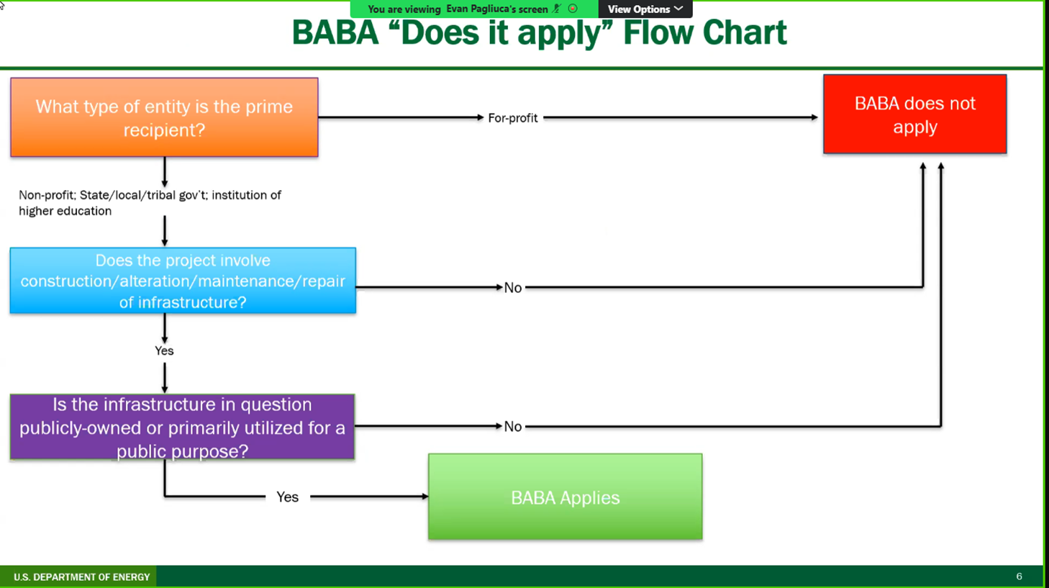
BABA

Slide 21
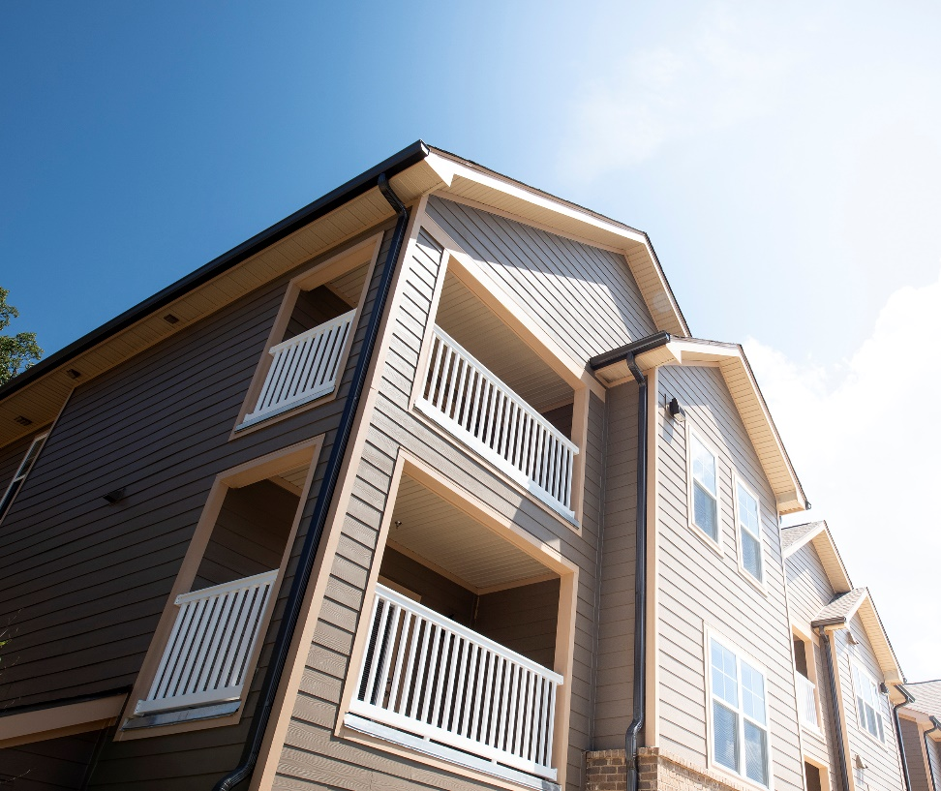
Multi-Family
Shalom Towers - Pilot
Arcadia Park
Recruiting Properties
Approvals
Audit Approval

Slide 22
LCP Tracker
Approval of your contacts
Project can only be entered after audits
Tracks wages for Davis Bacon
Only IIJA funding
Only 5 or more units per building

Slide 23
Policy Manual
Priority Points when state plan is approved.
New version released on July 1, which incorporates the Public Notices for the year
Will include more in-depth on multi-family

Slide 24

Optional Budget Categories
Creating optional budget categories for Intake, Audits, and QC Inspections allows for those expenses to be taken out of Program Support and to not impact ACPU.
KHC did a flat rate for audits and QCI to allocate funding to subgrantees, which was based on job production and deferral rates.
KHC allocated intake based on what subgrantees submitted that they needed.

Slide 25
Things We Do Not Know
Will DOE Formula start July 1?
Will LIHEAP be funded again?
Is anyone nationally advocating for Weatherization?
Will we get contracts July 1?
What money do we spend on July 1?
What is happening with solar?

Slide 26

SERC/Solar for All

Slide 27

90-Day No Cost Extension
What is it?
When will it affect us?
How will we know?
DO NOT PROCEED!!!

Slide 28
IIJA Extensions
History of IIJA funding
DOE obligating the 2nd half of the funding
Still must meet benchmarks before we can draw on it
For the moment, a large portion of it will remain as a performance pool so it is there when you need it.
Extended through 2029

Slide 29
Federal Staffing
DOE
9 Staff
Reduced from 35
Very few in Financial Accounting
Does KY have a PO?
HHS/LIHEAP
5 Staff?
Mostly in Accounting
Still have some contractors

Slide 30
Any Questions or Comments?
Discussion

Slide 31

Teamwork makes the dream work!
Keli’s vision –
Kentucky being the best.
Keli on NASCSP Board.
Keli on workforce development group.
Dewayne on JTPA working group for NREL.
Mark leading BPA group.
KY meets with Region 2 states once a month to support each other.
All Subs are a team. We are in this together.
Together we are greater than our parts.
Working together which includes funding re-allocations.
The better we work as a team, the stronger the chance that no one pays back money.

