Slide 2
2025 Homebuyer New Construction/AHTF HR Applications
Application Guideline Training

Slide 3
Funding Round

Slide 4
Homebuyer New Construction
Application Tips

Slide 5
Tips
Check Threshold
Read the scoresheet (scoring rubric) so you know how many points questions are worth.
The scoresheet will also highlight the types of benchmarks we are looking for in the answers.
Read the Application Guidelines and Policy Manual.
Watch Naming Convention!!

Slide 6
Threshold
Know your expenditure rates on projects (from PDMS)
Explain if you do not meet threshold.
The thresholds need to address HB/HR projects for both applications.

Slide 7
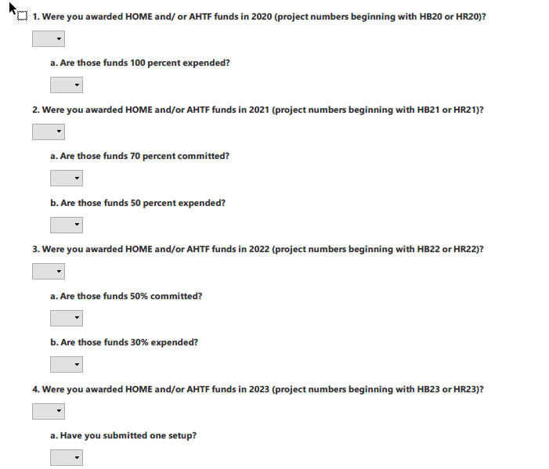

Slide 8
Question Concentration
Project Description – 10 points – Brief does not mean 2 – 3 sentences.
Additional Funding – highlight any funding you are using (2 questions & 10 points)
Be thorough in your answers and make sure that they answer the question.

Slide 9
Financial Design

Slide 10
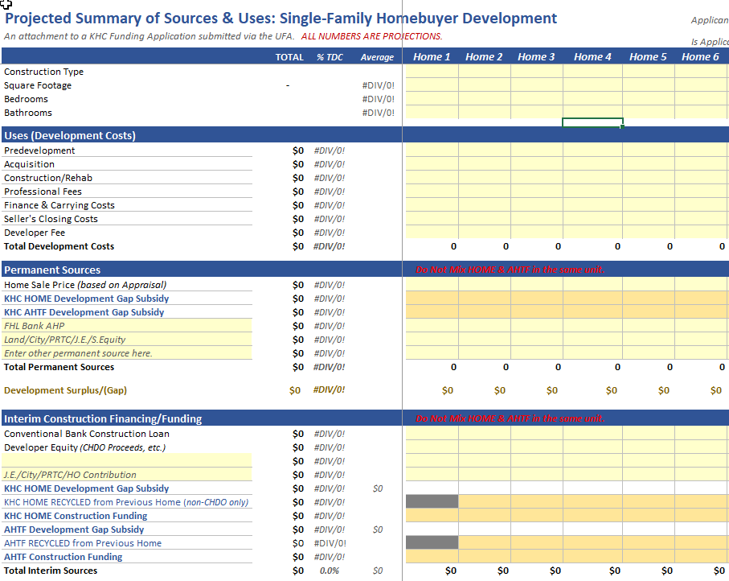

Slide 11
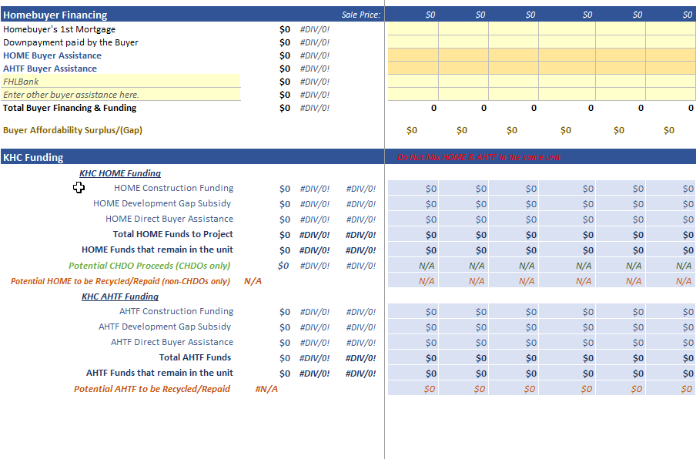

Slide 12
Sources & Uses
Example

Slide 13
Ready to Proceed
Marketing/Financials – give a decent answer – not just advertise on social media; Be specific.
Waiting List & Approved Plans – Easy points
Day-to-Day Operations – 12 points – Look at the scorecard

Slide 14
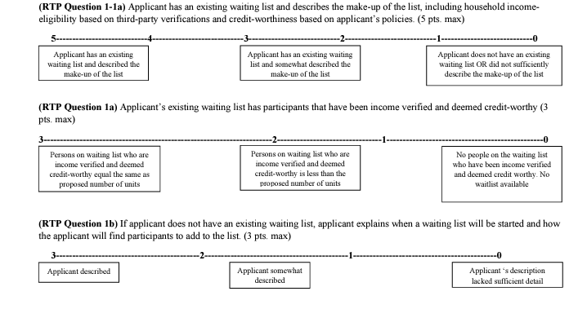
Wait Lists

Slide 15
Approved Plans

Slide 16
AHTF Home Repair
Tips

Slide 17
Tips
Check Threshold
Read the scoresheet (scoring rubric) so you know how many points questions are worth.
The scoresheet will also highlight the types of benchmarks we are looking for in the answers.
Pay attention to the question and what it is asking.
Be thorough in the answers.
If a question is worth 10 points, 2 – 3 sentences is not enough.
Read application guidelines.
Watch Naming Convention!!!

Slide 18
Threshold
Know your expenditure rates on projects (from PDMS)
Explain if you do not meet threshold.
The thresholds need to address HB/HR projects for both applications.

Slide 20
Sources & Uses
Example

Slide 21
Questions

