Slide 2
What is Weatherization?
Federal program – began in the 1970s
Funded under the Department of Energy & Health & Human Services Low-Income Heat & Emergency Assistance Program
KHC began administering it in 2009

Slide 3
How much does KY get?
DOE Formula = $6 million
LIHEAP Formula = $10 million
DOE BIL = $51,972,421

Slide 4
What does it do?
Conducts energy audits
Makes general repairs on deferrals
Installs energy saving measures/retrofits
Installs health & safety measures
Ensures quality through certified inspectors

Slide 5
Client submits application
Subgrantee checks income and dwelling eligibility
Walkthrough and/or energy audit/ Pre client education (similar to pre-construction conference)
Bid process (if applicable)
Perform weatherization work
QCI/Post client education
Pay contractors
Invoice for reimbursement
Weatherization
Process

Slide 6
How to get applications?
Advertise
Look at all possible applicants
We are working on getting an online application
Renters can get help too

Slide 7
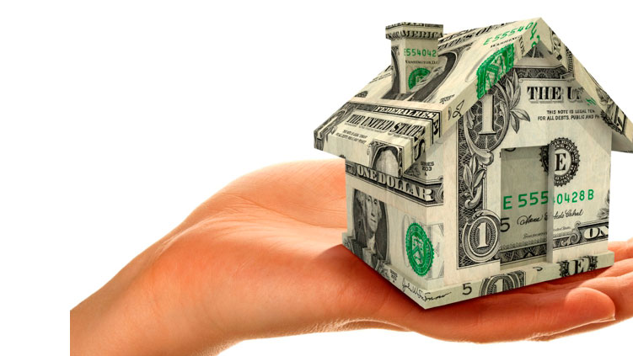
Income
WX800 – Application generated from Hancock
Backup documentation
Income – must be at 200% of Poverty Level (housing programs = 80% AMI)
Income Formula is in WX Program Manual

Slide 8
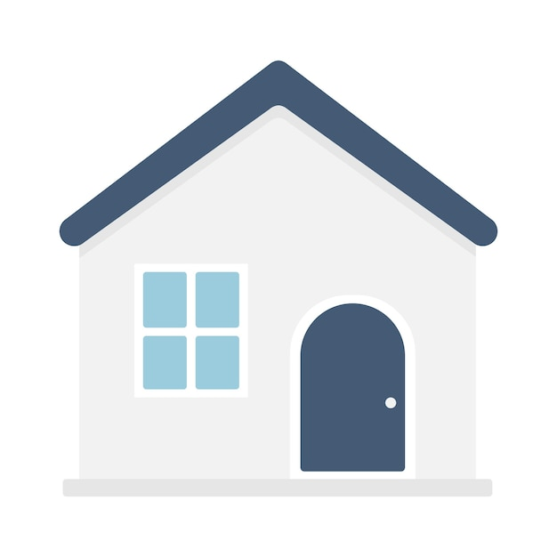
Dwelling
No Multi-family for the moment (5 or more)
Owner or Renter – deed or lease?
Renter – Landlord must agree to the program
Re-weatherization
DOE – 15-year rolling date
LIHEAP – on or before September 30, 2012

Slide 9
Client Utility Cost Calculation
Collect utility bills for the 12-month period prior to the calculation
If no 12 month, subgrantee can annualize
Minimum usage fees should be included
Need for the NEAT/MHEA

Slide 10
Priority Points
Elderly
Disabled
Children below the age of 6
Energy burden
Immediate service to families in danger of losing their children due to a weatherization issue.
WXPM Page 27-29

Slide 11
Energy Burden vs. Energy User
High Energy Burden
Costs of utilities are 34% or more of income.
High Energy User
Costs of utilities are high.

Slide 12
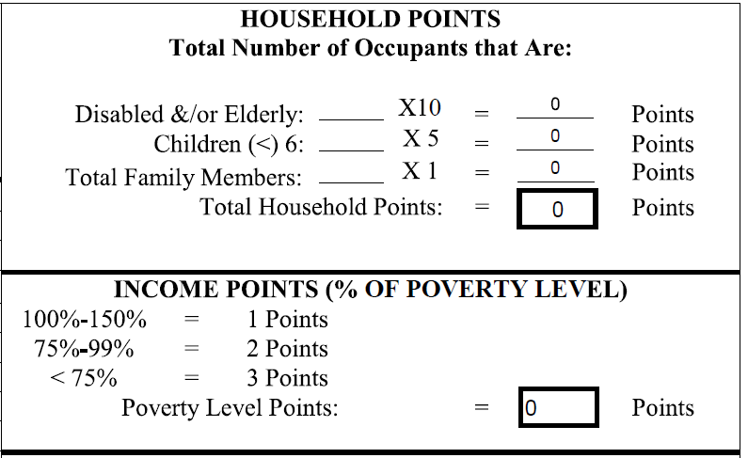

Slide 13
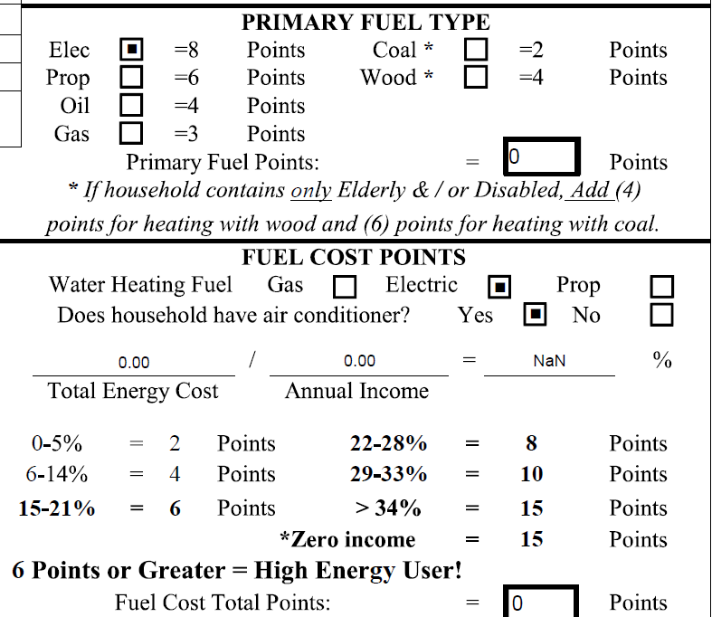

Slide 14
How many applications do you need?
Not every application becomes a project
Ineligible client
Deferrals and cancellations
48% deferral rate! This means nearly half of your applications are not going to turn into projects or completions!!!
This does not actually account for all deferrals since they were not required to be entered for the entire year. Some of your data suggests needing 5-6 applications per completed unit.

Slide 15
How much does it cost?
No cap on health & safety but must seek approval over $4,000
Energy Conservation Measures should average $8,250 (in 2024) in DOE funding (no cap in LIHEAP funding)

Slide 16
What are energy retrofits?
Air sealing (caulking windows, doors, and cracks)
Adding insulation (attics, walls, crawl spaces)
Replacing refrigerators and gas stoves (LH only)
Proper venting of clothes dryer
Ensuring heat is present

Slide 17
Are other general repairs allowed?
General repairs are allowed under Weatherization Ready.
Must be related to a deferral.
Cannot include all needed repairs; only repairs to prevent deferrals.

Slide 18
What is an appropriate deferral?
Health & safety – Ex: mold, pest infestation, asbestos
Housing Repairs – Ex: roof repair
Client issues – Ex: threats

Slide 19
Weatherization Ready
Set aside funds to address deferrals
Households that reach the top of the waiting list due to priority points but are deferred due to needed repairs.
Pre-inspection or complete walk through of home to identify all deferral reasons to determine eligibility
$10,000 ACPU
Repairs: asbestos, electrical, mold & moisture, pest infestation, roof repair, sanitary problems, structural, plumbing. (No major structure repairs)
5. Reach out to contractor for bid
Electrical, HVAC, & Plumbing must be a licensed contractor
6. Complete Wx Ready Repair Program Request and send to KHC
Include supporting documentation:
Audit/Scope of work for regular weatherization
Bid documentation
Photos
7. KHC reviews and approves or denies request
Complete repairs and invoice KHC
Project must result in a DOE Completion

Slide 20
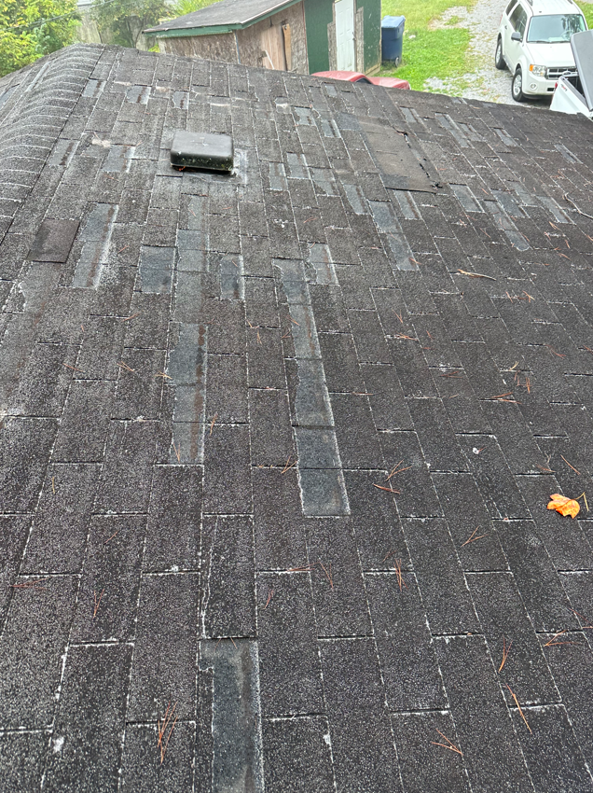
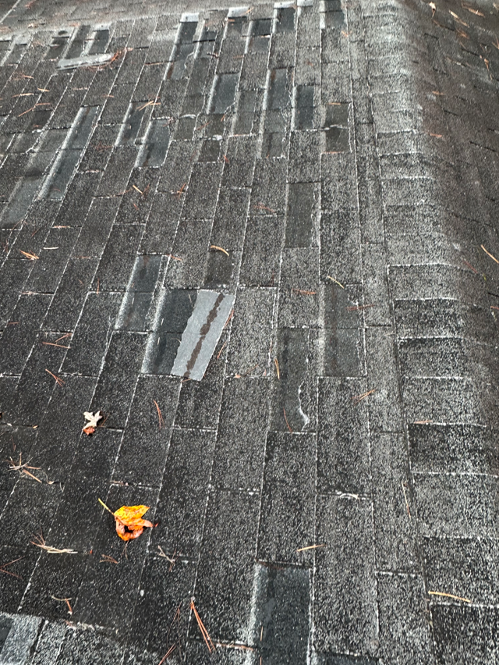
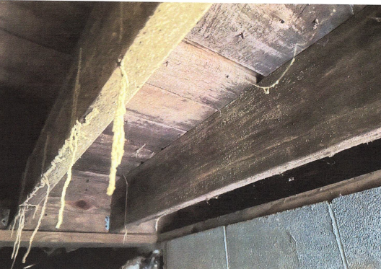
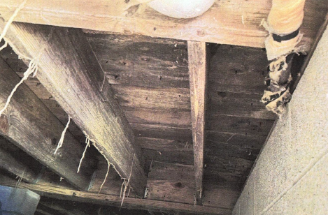
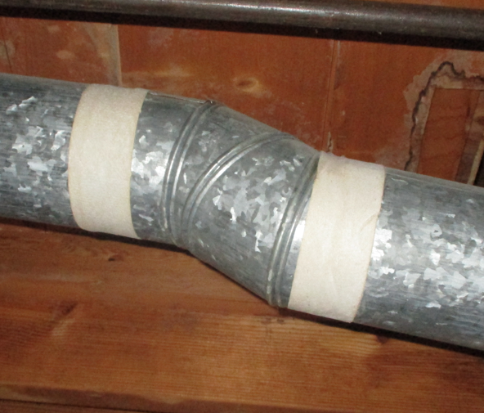
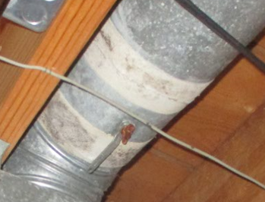
Examples of Weatherization Ready
Roof Repair
Asbestos
Mold & Moisture/Pest Infestation

Slide 21
Why Wx Crew do this work?
https://www.kyhousing.org/Partners/Developers/Single-Family/Weatherization-Assistance/Pages/default.aspx

Slide 22
AHTF Home Repair
KHC operated
Nonprofits must apply for funding
Not every area will have access to it
https://www.kyhousing.org/Partners/Developers/Single-Family/Pages/Housing-Developers.aspx

Slide 23
AHTF Home Repair At-a-Glance
Purpose | To stabilize the residences of low-income homeowners with essential repairs to keep or make their home habitable.
Eligible Households | Homeowners with combined household income <60% AMI and non-home assets valued at no more than $50K. Homeowners must have ownership interest in the land and the home to be repaired.
Eligible Properties | Single-family detached homes or qualified manufactured homes. Must be the homeowner’s primary residence.
Max Assistance | $20,000 per home. No additional AHTF can go to a home during the 5-year deed restriction. Assistance can be paired with other programs/funding sources.

Slide 24
Minimum Habitability Standards (MHS) Categories
Structure
Access
Space and security
Interior air quality
Water Supply
Sanitary Facilities
Thermal environment
Illumination and electricity
Food preparation
Sanitary conditions
Fire safety
Accessibility
OPTIONAL Improvements (if funding allows): installation of a second entrance/exit (ingress/egress); air conditioning; repairs to a 2nd bathroom; replacement of functioning home systems that are at/near the end of their useful life; and/or energy-efficiency improvements

Slide 25
USDA 504 Program
Loan or Grant
62 and over grant ($7,500 or $10,000 in a lifetime)
Over $7,500 it is a loan
80% AMI
Rural area (most of KY except Northern KY, Louisville, Lexington, Bowling Green, Owensboro, Hopkinsville, etc.)

Slide 26
Questions?
Keli Reynolds 502-564-7630, ext. 414 kreynolds@kyhousing.org

