Slide 2
Partner Training
Single Family Development

Slide 3
Definitions
Development Subsidy/Development Gap- difference in total development cost and appraised value.
Direct Subsidy/Homebuyer Assistance- money going into the project to make the home more affordable to the buyer.
Developer Fee- developers compensation
Appraised Value (Purchase Price)- Fair market value of property.
This Photo by Unknown Author is licensed under CC BY-SA

Slide 4
CHDO. No, really! What is it?
Nonprofit, community development organization
Primary purpose = affordable housing
Must meet HUD criteria
Public Jurisdictions (PJs) must set aside at least 15% for CHDOs.

Slide 5
How does it work?
1. Organized Under State/Local Law.
2. Nonprofit Status.
3. Purpose of Organization.
4. Board Structure.
5. No For-Profit Control.
6. No Individual Benefit.
7. Clearly Defined Service Area.
8. Low-Income Advisory Process.
9. Capacity/Experience.
10. Community Service.
11. Financial Accountability Standards.

Slide 6
What are CHDO Proceeds?
TDC = $200,000 Sales Price = $180,000
HOME Financing = $200,000
Development Gap = $20,000
Direct Subsidy = $40,000
CHDO Proceeds or Program Income = $140,000

Slide 7
How hard is it to track CHDO Proceeds?
We have quarterly reports that are submitted to KHC, which help track them.
Most organizations keep separate accounts.
And, then, there is the “washing”!

Slide 8
Washing sounds scary!
CHDO Proceeds can be used.
CHDO Operating
HOME-eligible activities
Other housing activities to benefit low-income families
Once they are used in a project (washed), they lose their HOME identity and can be used as revenue.

Slide 9
Example of Washing CHDO Proceeds
TDC = $200,000 Sales Price = $180,000
CHDO Proceeds = $150,000 AHTF= $50,000
Development Gap (AHTF) = $20,000 Direct Subsidy (AHTF + CHDO Proceeds) = $40,000
CHDO Proceeds Washed = $140,000

Slide 10
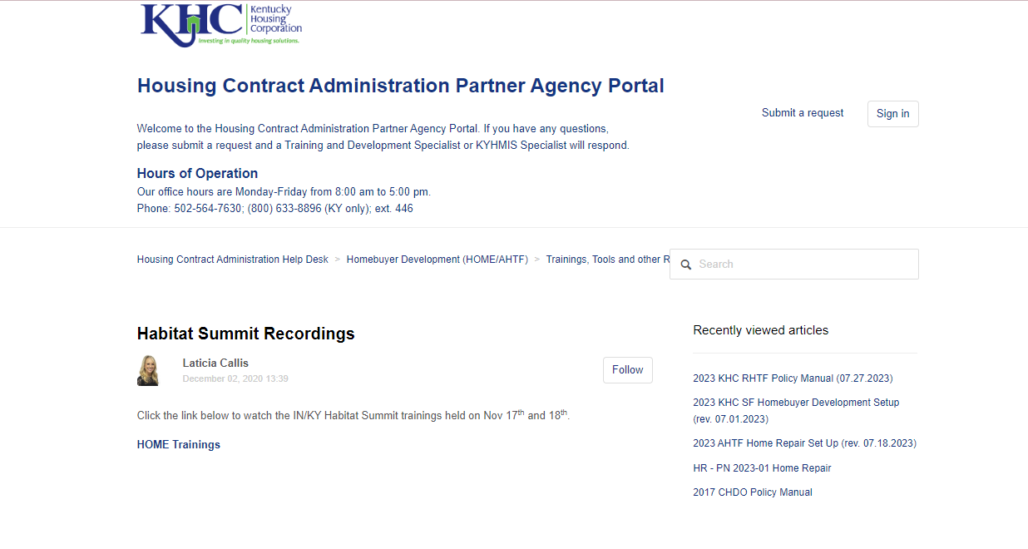
CHDO Training
Visit KHC’s HCA Help Desk and look under Homebuyer New Development for Habitat trainings.

Slide 11
CHDO Operating
Awarded each year for operating expenses
Process
CHDO Grant Agreement
Executed/Project Setup in draw system
Release of Funds
Request Access to the project
CHDO Quarterly Reports – submitted with quarterly draw. Final draws are due by July 31st.

Slide 12
The Process
Find the most recent set-up packet on HCA Help Desk.
Complete set-up packet with ERR in HEROS.
Submit items on the checklist
Send checklist items and excel workbook to hcadev@kyhousing.org.
KHC HCA staff reviews

Slide 13
The Process (continued)
5. HOME Developer Written agreement is processed . . .
KHC will draft and send to you for review and signature.
You send back to KHC.
6. KHC loads into IDIS.
7. KHC sends activity approval/release of funds with executed DWA.
8. Construction + Inspections begin.

Slide 14
Case Study: Set-Up & PCR
See Set-up and PCR.

Slide 15
Learning Opportunities
Evidence of supporting projected appraised value with either an appraisal determining the purchase price or like appraisal that is comparable to the purchase price.
Construction Contingency (5.0%-7.5%)- is used in the project to account for unanticipated costs. If any contingency goes unused, those funds are sent back to KHC to the project level.
Any borrower contributions are included in the buyer affordability tab only.
Make sure all supporting documentation for the set-up is completed and signed by all parties.
This Photo by Unknown Author is licensed under CC BY-SA

Slide 16
Submitting Closing Docs
Find KHC’s Closing docs listed on Help Desk
Complete closing docs and send to hcadev@kyhousing.org for KHC to review.
KHC will send closing doc review approval and PCR can be submitted in draw system.
NOTE: All mortgage/notes/deed restrictions must be executed at closing not set-up.

