Slide 1
Interactive Weatherization Training
August 23, 2023

Slide 2
Housekeeping
Cost allocation for this meeting:
DOE Formula = 50%
DOE BIL = 50%
Open discussion
Restroom location
Don’t forget to get your parking tickets validated!

Slide 3
Superlatives
Closest Average
Central KY -$8,009!!
Formula Most Completions
Multi-Purpose- 28 Jobs!!
BIL Most Completions
Northeast – 24 Jobs!!
Most Improved
Northern KY- increased production
Wx Ready Stars
MPCAA, WKAS, & Big Sandy

Slide 4
Conflict of Interest
Determine a conflict of interest
Notify KHC
Narrative of conflict
Letter for legal counsel
Evidence of public disclosure (e.g. social media, board minutes, newspaper
Submit waiver through draw system

Slide 5
State Plan Changes
H&S $3,000 to $4,000
Air conditioning for medical reasons
ACPU $8,250
IRM’s

Slide 6
IRM New Policy
Must include in measure
Measure must SIR at least 1.0 or .6
If SIR is lower than requirement, pull out IRM and make it a separate measure for a total package SIR of 1.0
Separate measure in Hancock (Incidental Repair)

Slide 7
IRM’s
There is no longer a price limit on IRM’s.
An IRM must be first attached to an ECM (for example gutters can be attached to attic, walls, or floor to solve moisture issues). That ECM must hold an allowable SIR.
If the IRM materials and labor drop the ECM SIR below acceptable then you can enter it as an itemized cost with an SIR included, that way it adds that measure to your cumulative SIR.
An IRM according to DOE is anything that is not specifically required to perform that measure.
Ancillary items are materials needed to properly perform that measure and are an allowable cost under the measure (for example insulation rods, baffles, junction markers, depth markers, etc. are all ancillary items.)
According to DOE things such as access entry door repairs or replacement, wall ceiling or floor repairs, gutters, sump pumps, waterline insulation, are all incidental repairs and need to be listed that way in the work order as IRM materials and IRM labor.

Slide 8
IRM
IRM Examples
Gutter installation due to moisture issues in walls, floors, or attic.
Mobile home door replacement due to moisture issues in floor.
Sump pump installation for moisture issues in floor.
Minor roof repair for moisture issues in attic.
Waterline insulation installation in floor.
Minor wall, ceiling or floor repair in order to perform insulation measure.
Repair or replacement of access doors for floor or attic.
When no access is present, and one must be installed in order to perform a measure it is no longer an IRM. For example, a Knee wall that does not have an access door an access must be created in order to perform that portion of attic insulation and air sealing.

Slide 9
Deferrals
What is an appropriate deferral?
Health & safety – Ex: mold, pest infestation, asbestos
Housing Repairs – Ex: roof repair
Client issues – Ex: threats

Slide 10
Weatherization Ready
ACPU increased to $10,000
DOE ACPU currently at $2,489
Common Wx Ready jobs
Asbestos, electrical upgrade, pest infestation, mold and moisture, flooring repairs
Job Costs
Minimum- $280 (Pest Infestation)
Maximum- $9,724 (Roof Replacement)
Updated Wx Ready Spreadsheet
Located on the Agency Partner Portal
Wx Ready can be used with DOE Formula or DOE BIL funded projects.

Slide 11
IRM vs Wx Ready
IRM
Wx Ready
Structure repair- minor wall, ceiling, or floor repair in order to perform insulation measure and falls within SIR.
Minor roof repair- patching or shingle replacement to protect attic or roof insulation.
Mobile Home Door- if insulating floor.
Structure repair- major wall, ceiling, or floor repair in order to perform insulation measure.
Major roof repair or replacement
Mobile Home Door- if not insulating floor and has major air sealing issues.

Slide 12
Production Planning & Budgeting
Identify target number of units
Program Operations/ACPU
174,000 / 8250 = 21 units
21 units / 12 months = 2 units/month
Possible Impacts to Monthly Schedule
Holidays/Vacations/Hunting Season/School Breaks
Weather Delays
Required Training
**Subcontractor Availability & Capacity**
**Material Supply Delays**

Slide 13
How many applications do you need?
Not every application becomes a project
Ineligible client
Deferrals and cancellations
Do you know your deferral rate??
Hancock has a report for that!!
Report > Performance Report
As a network, our deferral rate can be calculated as Units Denied / (Units denied + Completions)
48% deferral rate! This means nearly half of your applications are not going to turn into projects or completions!!!
This does not actually account for all deferrals since they were not required to be entered for the entire year. Some of your data suggests needing 5-6 applications per completed unit.

Slide 14
Things to Consider
How long does your process take from audit to job completion?
Weatherization Ready can assist you in reducing your deferral rate by turning previously ineligible dwellings into viable projects.
Separate production planning for DOE BIL and DOE formula funds
Your DOE BIL contracts go through June 30, 2024
DOE BIL cannot be used with DOE Formula except in the case of WX Ready
Weatherization Ready averages same as other projects. How many deferrals can you turn into completions with your allocation?

Slide 15
Budgeting Completions to Meet ACPU
Average Cost per Unit includes materials, labor, program support, and Vehicle & Equipment purchases
WX23 network average Program Support to Total Program Operations was 48%
Highest was 84%
Lowest was 15%
Everyone received an email detailing their Program Support percentage
Example
$8,250 x 48% = $3,960 per unit in indirect costs
$8,250 - $3,960 = $4,290 materials and labor to stay at ACPU
Still doesn’t account for Vehicles & Equipment purchases! Proceed cautiously.
Some projects will come in higher, but you need to balance those with less expensive projects to maintain a reasonable average.
BIL ACPU is still $8,009 and will remain there for the entirety of the contract so plan accordingly with those projects.

Slide 16
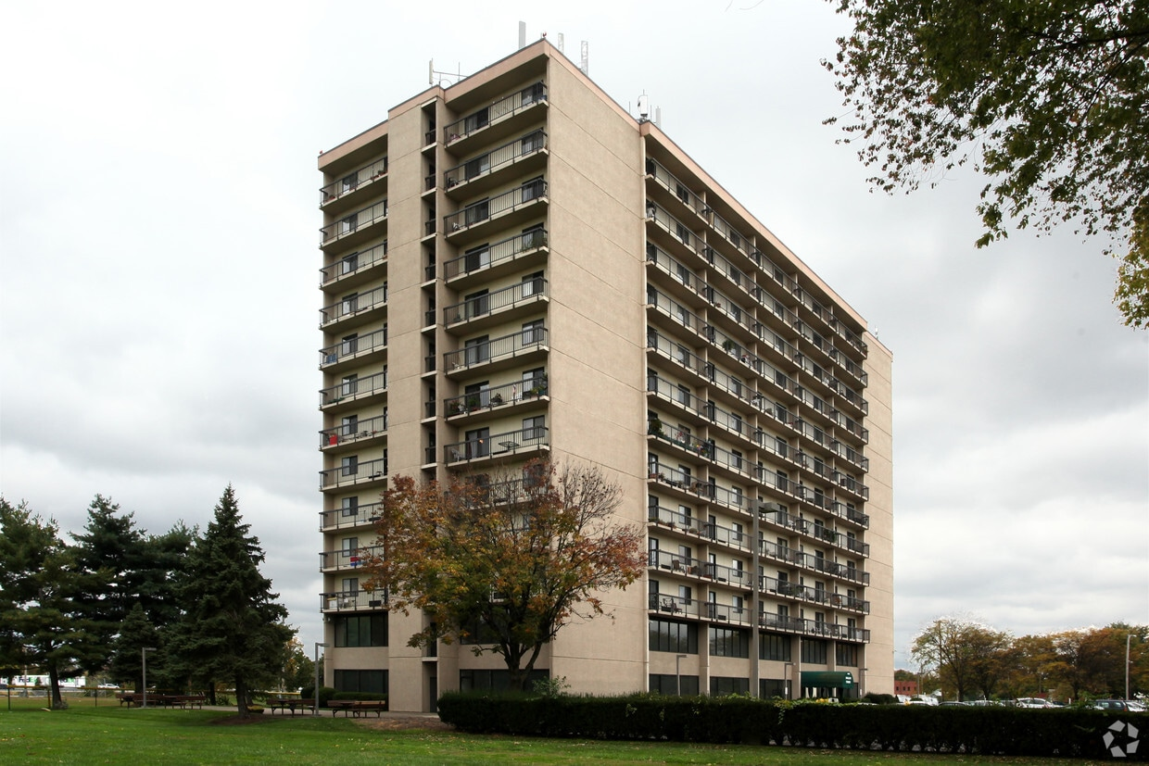
MF- Shalom Tower Highlight
MPCAA- Marsha Fenwick

Slide 17
Financial/Admin Monitoring
Top 10 Monitoring Issues

Slide 18
10. Documentation of administrative costs do not match what is billed to KHC.
Agencies must have supporting documentation to back up the costs charged to the program.
Cannot take the maximum admin amount “just because that’s what’s allowed.”
If agencies bill $1500, there must be expenses and records that match that amount.
This is true for all cost categories, but it is seen most often in admin.

Slide 19
9. No preparation.
Prepare every item listed on the checklist.
Do not say: “You looked at that last year.” Some documentation pieces must be looked at every year.
Have all documentation organized for a much smoother/faster monitoring.

Slide 20
8. Procurement P&P doesn’t align with 2 CFR 200.317-200.327
Should detail cost thresholds and who is responsible for approval at each level
Identify when quotes, sealed bids or requests for proposals are required
Agencies should create their OWN policies; not copy and paste the CFR’s. They are meant to be a guideline of what is required.

Slide 21
7. Agency policies and procedures don’t match actual practices.
Follow the monitoring tool to determine the minimum written policies that are required.
*NEW*- Conflict of Interest policy: Section 1.6 in WAP Manual
Written policies should match how the agency’s program is operated
Example: The P&P states the priority list is updated quarterly, but the agency updates every six months instead.
Example: The P&P states the priority list is organized by county, but actual lists has all counties together on one list.

Slide 22
6. Proper bid procedures aren’t followed.
Sealed bids aren’t used.
Contractor bids are changed.
Not acceptable to change a contractor bid. The change order will document if a change to the bid price is made.
Is acceptable to document a math error on the bid. Write a note with the correct price, indicate there was math error and initial.
Bid opening sheets have errors
Need to list agency cost estimate
List all bids received
List the date of the bid opening

Slide 23
5. Inconsistent dates/signatures on paperwork.
Applications dated after the initial evaluation
Updates to applications should happen prior to the evaluation
Applications approved after the evaluation
Applications not approved at all
Paperwork missing required signatures
WX-15, Change Order must be signed by WX Director, DNE, Contractor, and client
DNE signatures missing on client ed forms, mold forms, etc.
Applications missing appropriate signatures

Slide 24
4. Priority lists are hard to follow.
Should be able to look at a priority list and determine what units are in progress
Notes should be included to detail a client’s status: completed, in-progress, deferred, etc.
The priority list should PROVE that you are serving clients in order by points! A list of clients in order by points doesn’t prove anything unless there are notes indicating when the clients are served.
Should include the date the list was created

Slide 25
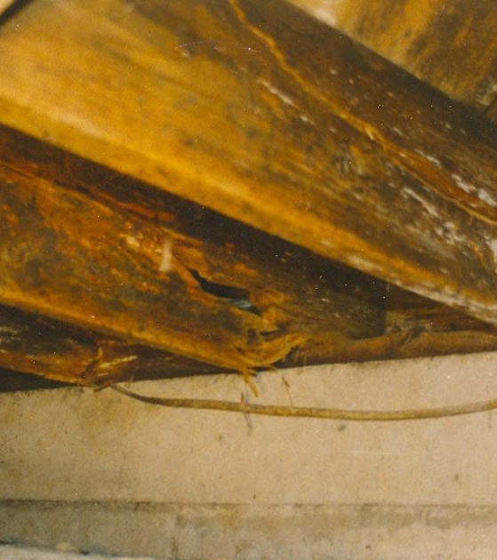
3. Deferrals
Letters not sent in a timely manner (best practice: approximately within 30 days of the evaluation)
Letters do not specify the reason for deferral
Give the exact reason for the deferral. Don’t list “structure” or “clutter.” Give a short 1-2 sentence explanation.
For example: structural issues to flooring: “Floor joists are rotting in places and unstable.”
Clutter-”Cannot access all areas of the home due to excess items. The evaluator and work crews need to be able to access all parts of the home to insulate and make the home more energy efficient.”
Letters do not provide referral information
Provide clients with contact information for the referral agency
No deferrals at all
If you can’t complete the evaluation due to a problem with the client or unit, it’s a deferral and should be reported

Slide 26
2. Trainings not maintained for employees/contractors.
Use the state plan to determine what trainings are required for contractors and employees.
Plan ahead! Prepare for trainings that are expiring well before the due date.

Slide 27
1. Errors on client applications.
Income not calculated correctly
Use the formulas included in Section 2.2.2 in the WAP manual!
Medicare premiums should be deducted from gross income
Get income documentation from the month preceding the application
Make sure income on application matches the income documentation!
Points total not correct
Disability status must be proven to get points
If you correct an income error, be sure to check the points.

Slide 28
Best Practices-How to Ace a Monitoring
Invoice: Tell the whole story! Print any worksheets that you use to reconcile each month. If it’s helpful to you, chances are it will be helpful to your monitors.
Highlight/tab items to help monitors reconcile what was billed to KHC.
If possible, print payroll reports with hours worked and payroll amounts to help monitors reconcile hours worked in WX with what is billed to KHC.
Update agency policies and procedures when preparing for a monitoring.
DOCUMENT! DOCUMENT! DOCUMENT! Make notes when something is out of the ordinary.

Slide 29
Best Practices-How to Ace a Monitoring
Review applications before approving them. If you are the person responsible for approving applications, then it is your job to ensure the household is eligible for the program.
Double check all signatures.
Make sure dates align and make sense.
Communicate with your intake workers and Wx bookkeeper.
Create reminders in Microsoft Outlook for important dates.
Training expirations
Contractor insurance expirations
If you aren’t sure about something on the checklist or monitoring tool, ask!
Leslie’s cell: text or call 606-813-6684
Can return text messages quicker than emails.
Poor cell reception during the day for phone calls, but can return calls after 3:30 or sometimes during the day.

Slide 30
Discussion Questions
Workforce Development
What can KHC do to help you?
Would it help for KHC staff to do training with your CSBG workers?
What is your plan to increase contractors and/or crew?
What are you two biggest obstacles with workforce?
Application Pool
What strategies are you using to increase the application pool?
Client Education
What materials do you use for client education?
Who does client education?
Do you need materials in other languages?
What are the challenges with client education?

